Slide 1
Maritime resource names (MRN) it’s value and use
Minsu Jeon, Technical Operations Manager

Slide 2
Contents
    Unique identifier
    Technical aspects
      URI, URL, URN
      Example
    MRN
    Value and potential uses
    MRN registry
    Procedure
    Way forward

Slide 3
Unique identifier for all types of resources
AtoN
e-Navigation
Lights
Organizations
AIS
People
Message ID
Equipment
Buoys
Container ID
Publications
Communication channel ID
Berth No.
Navigation Aids
IMO number
Nautical Charts
Electronic services
VTS
MMSI
Maritime Resources

Slide 4
What is Maritime Resource Names (MRN) ?
MRN is a naming scheme that can uniquely identify any maritime resource on a global scale. This could be organization, employees, a person, a physical or a virtual object, for instance, an electronic document, a buoy, a ship, a mariner, a nautical chart or an electrical service.
MRN will be an essential method to identify all maritime resource machine readable in the e-Navigation environment.

Slide 5
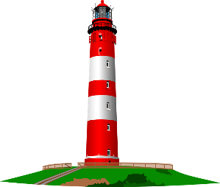

URI, URL, URN
URI (Uniform Resource Identifier)
<Scheme>:<Scheme-specific-structure>
URN (Uniform Resource Names)
Paul Petry
urn:mrn:iala:person:nnnn.n
URL(Uniform Resource Locator)
10 rue des Gaudines 78100
Saint Germain en Laye
http://iala-aism.org/
What
Where

Slide 6
Example of URN
URN | corresponds to
urn:isbn:0451450523 | The 1968 book The Last Unicorn, identified by its book number.
urn:isan:0000-0000-9E59-0000-O-0000-0000-2 | The 2002 film Spider-Man, identified by its audiovisual number.
urn:ISSN:0167-6423 | The scientific journal Science of Computer Programming, identified by its serial number.
urn:ietf:rfc:2648 | The IETF's RFC 2648.
urn:mpeg:mpeg7:schema:2001 | The default namespace rules for MPEG-7 video metadata.
urn:oid:2.16.840 | The OID for the United States.
urn:uuid:6e8bc430-9c3a-11d9-9669-0800200c9a66 | A version 1 UUID.
urn:nbn:de:bvb:19-146642 | A National Bibliography Number for a document, indicating country (de), regional network (bvb = Bibliotheksverbund Bayern), library number (19) and document number.
urn:lex:eu:council:directive:2010-03-09;2010-19-UE | A directive of the European Union, using the proposed Lex URN namespace.
urn:lsid:zoobank.org:pub:CDC8D258-8F57-41DC-B560-247E17D3DC8C | A directive of the Life Science Identifiers may be resolved to http://zoobank.org/urn:lsid:zoobank.org:pub:CDC8D258-8F57-41DC-B560-247E17D3DC8C .
Source: Wikipedia

Slide 7
Maritime Resource
Maritime
Resource
should have an unique identifier
so that people and systems could distinguish it from any other resources
should be addressable
should have a rough location to be capable of being manipulated using a syntax

Slide 8
Requirements for MRN
Unique. Every id that is created must differ from any other id that is created.
Decentralized. It must be possible to create IDs without relying on a single global source that must be used every time an ID is created.
Forward compatible. It must be possible to add new naming schemes for new maritime domains in the future. Technologies will only come and go with an ever-increasing rate in the coming years.
Flexible. The naming scheme must be very flexible and allow for identifying any type of resource such as documents, cargo, routes, equipment, ships and mariners, giving no preference to any specific type of IDs.

Slide 9
MRN syntax
URN:OID:OSS:OSNID:OSNS
The basic syntax for a MRN is defined using the Augmented Backus-Naur Form (ABNF) as specified in [RFC5234]:
<MRN> ::= "urn" ":" "mrn" ":" <OID> ":" <OSS>
[ rq-components ] [ "#" f-component ]
<OID> ::= (alphanum) 0*20(alphanum / "-") (alphanum) ; Organization ID
<OSS> ::= <OSNID> ":" <OSNS> ; Organization-specific string
<OSNID> ::= (alphanum) 0*32(alphanum / "-") (alphanum) ; Organization-specific namespace ID
<OSNS> ::= pchar *(pchar / "/") ; Organization-specific namespace string
DIGIT ::= %x30-39 ; 0-9
ALPHA ::= %x61-7A ; a-z
The entire MRN is case-insensitive.

Slide 10

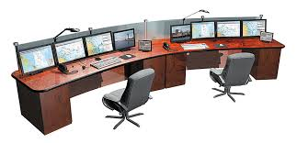
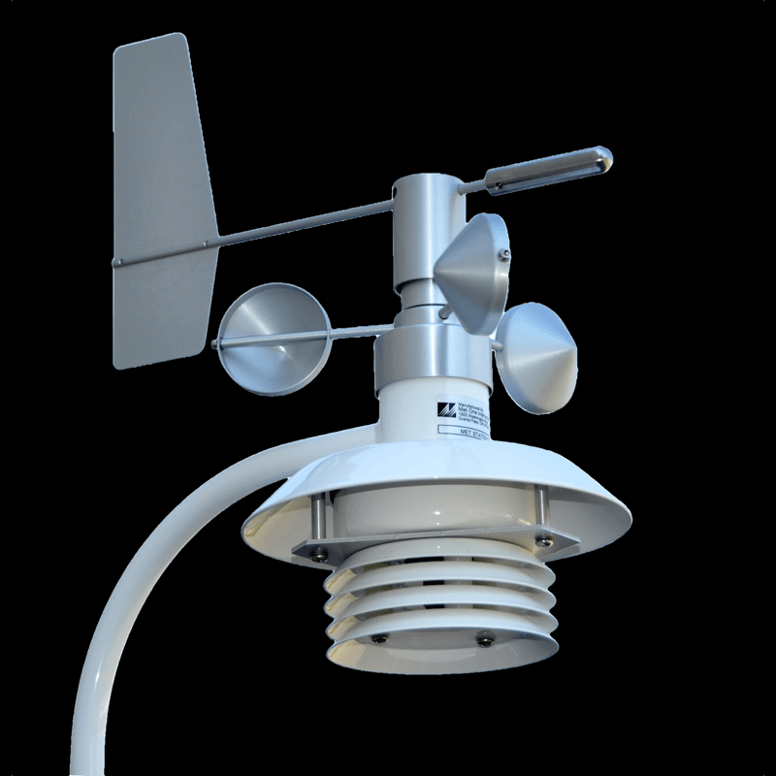
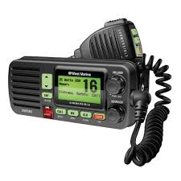
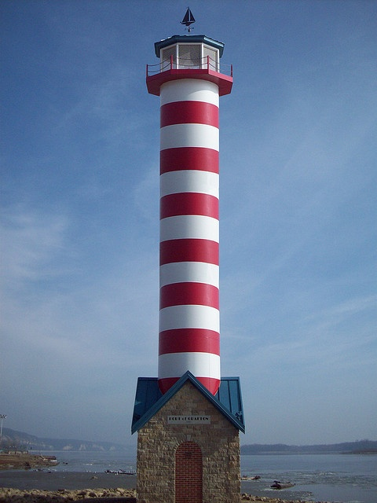
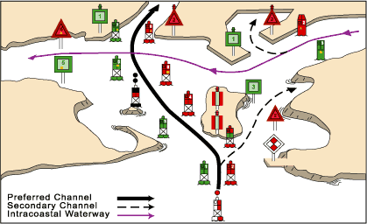
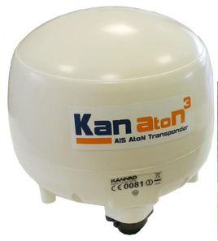
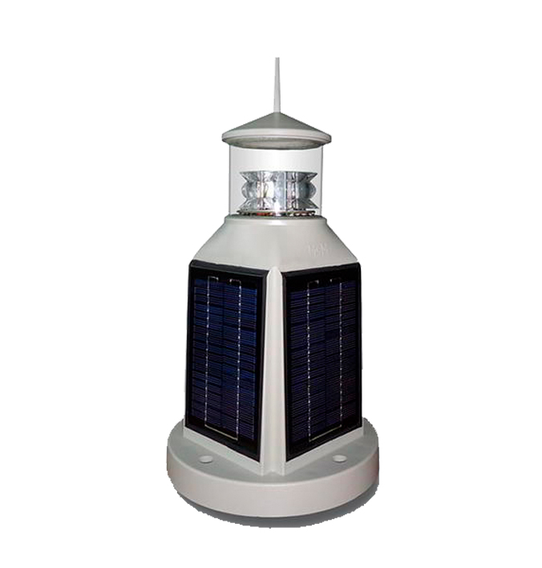
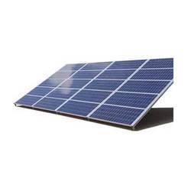
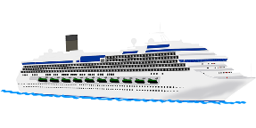
MRN

Slide 11
Use of MRN
E-Navigation services
Information exchange
- VTS services
- S100/200
- MSI
- etc.
Communication
- AtoN authorities
- Hydrographic offices
- Military
- Meteorology service
- Port service
- University
- etc.
Maintenance
- AtoN monitoring
- Inventory management
- etc.

Slide 12
MRN structure(Example)
:Resource
owner
:Resource type
:Resource sub type
:Resource instance
URN
MRN
Country A
AtoN
Lighthouses
nnnn.n
Buoys
nnnn.n
Equipment
nnnn.n
Remain fixed
Hydrography
Nautical charts
Notice to mariners
…..…
Coastguard
Weather infor
Country B
AtoN
Lighthouses
nnnn.n
IALA
Publication
nnnn.n
IHO
Feature types
nnnn.n
IMO
IMO number
nnnn.n
ITU
MMSI
BIMCO
Member
CIRM
IEC
Collected and shared
Matter for the resource owner

Slide 13
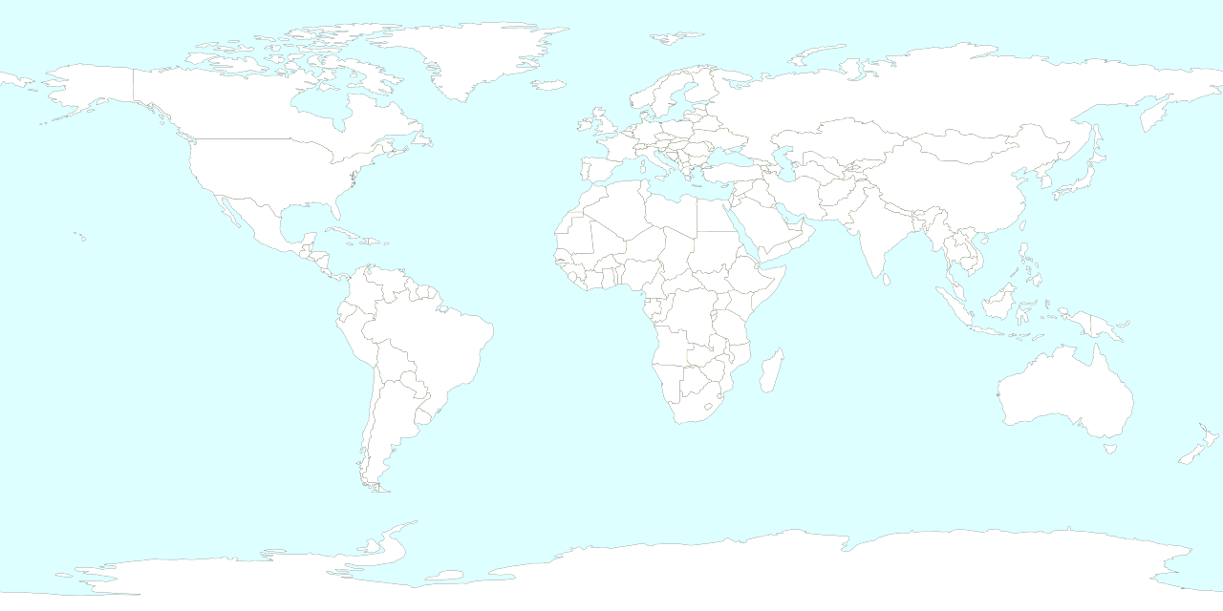


MRN registry
IHO
IMO
CIRM
BIMCO
WMO
Data collection
Information
Service
Country A
List of lights
MSI
Risk Assessment
e-Navigation
Big data analysis
Country B
MRN Database
Country C

Slide 14
Procedure on obtaining the MRN
Representative of recognized organization
IALA secretariat
mrn@iala-aism.org
Template
Arrange of MRN
Organization ID
IALA Domain Administrator will:
Validate the request of the recognized organization;
Update the organization ID
Inform the organization of the decision
When there is an appeal:
Forward the appeal to IALA DSG for final decision;
Inform the appellant of the decision

Slide 15
Way forward
Discuss about MRN concept
The google group: https://groups.google.com/forum/#!forum/mrn-discuss
Join IALA Technical committee to develop a guidance

Slide 16
Questions?

