Slide 1
E-Navigation Underway
Setting the Scene
February 6th 2019
Anette Dybdal Fenger
Director of Business Intelligence and IT-Development
Danish Maritime Authority

Slide 2

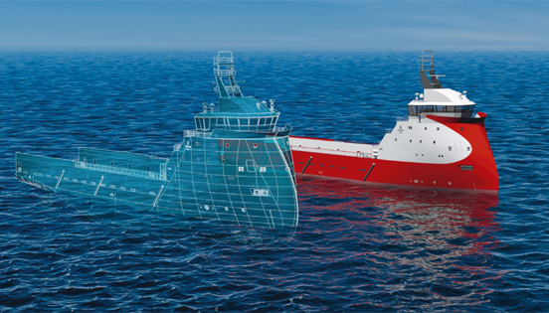
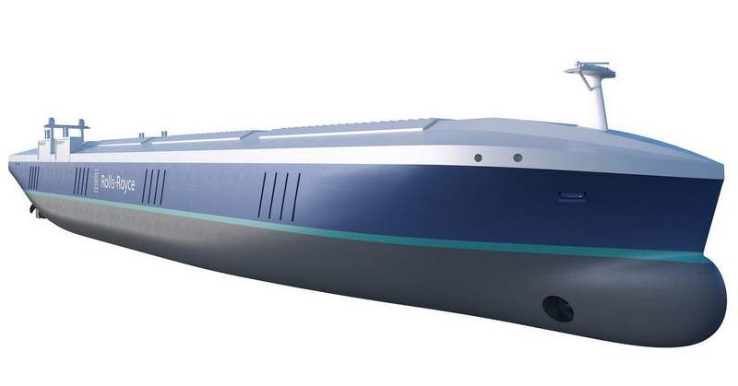
Digitalisation

Slide 3

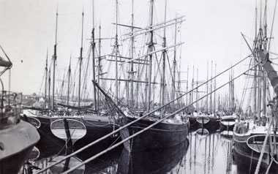
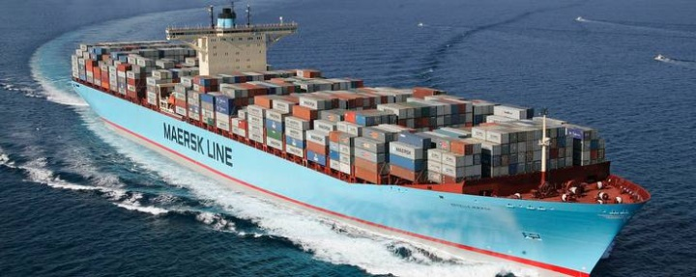
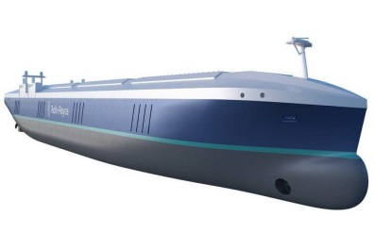
Technolical Development it is happening now
?

Slide 4
Digitalisation
2019
Internet of ships
20XX

Slide 5
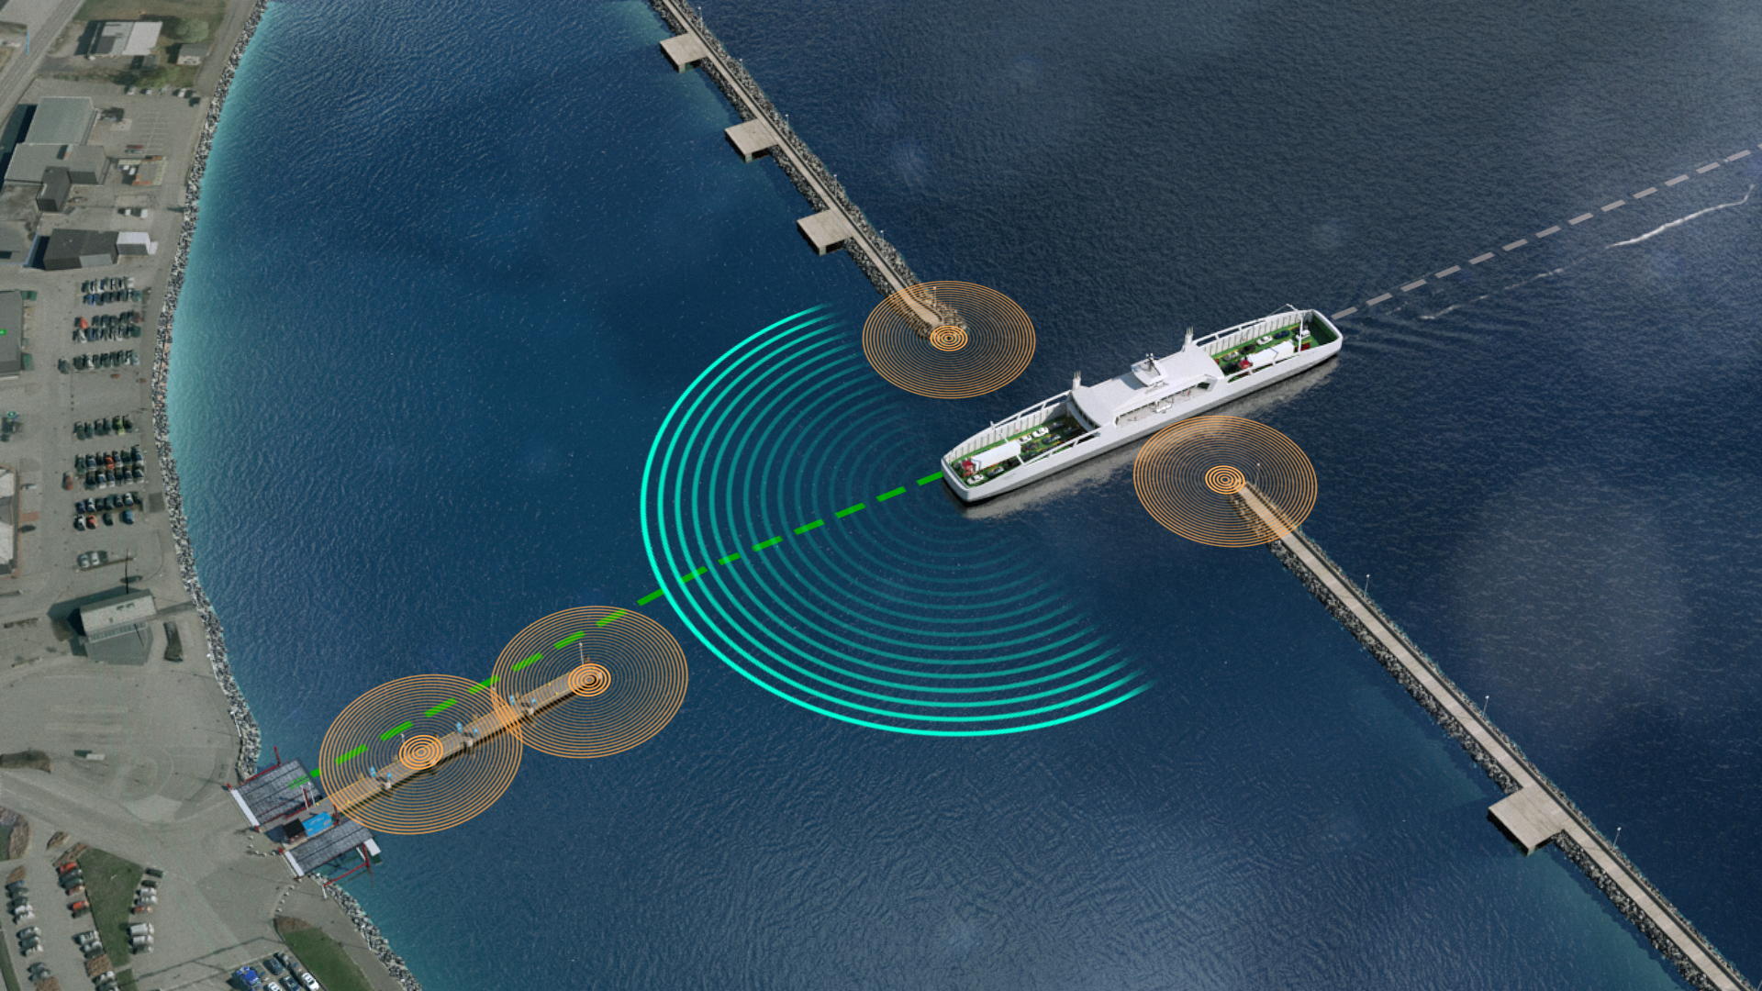
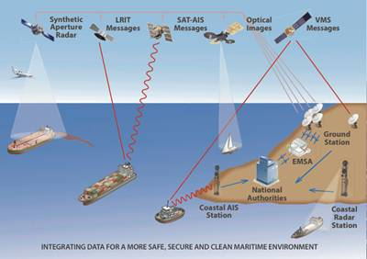
Digital Infrastucture

Slide 6

the Conference Program

Slide 7
THANK YOU
FOR YOUR
ATTENTION

