Slide 1
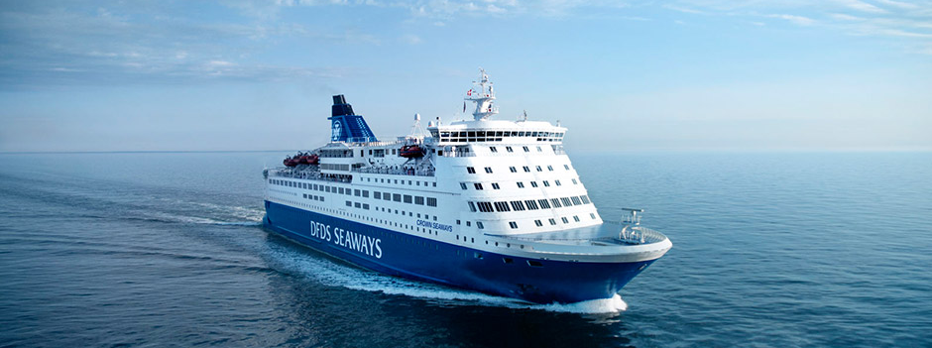
Welcome address
Conference opening

Slide 2
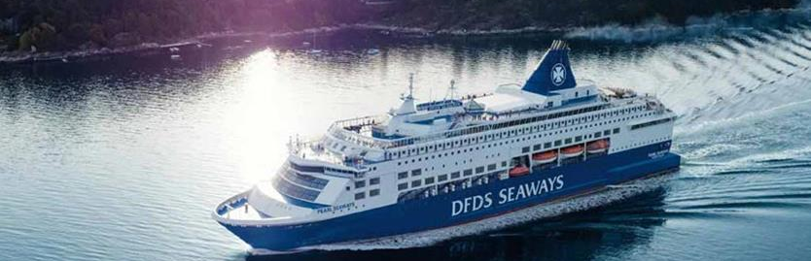
- Back to basics
- returning to the simple and most important things
- Find the business case
- a justification for a proposed project or undertaking on the basis of its expected commercial benefits
- Look through the “Hype”
- promote or publicize (a product or idea) intensively, often exaggerating its benefits
... focusing on benefits and barriers when implementing e-Navigation technologies.

Slide 3
E-Navigation
The definition (2005-2008)
E-navigation is defined as “the harmonized collection, integration, exchange, presentation and analysis of marine information on board and ashore by electronic means to enhance berth to berth navigation and related services for safety and security at sea and protection of the marine environment.”
Notes:
E-Navigation is not very complicated and is in reality just a matter of filling the technology gab in a quite conservative sector.
Some time ago I was invited to see the largest containership in the world. It was completely amasing and very impressive, but when I came on the bridge I could recocnise many of the equipment from my time at the Naval academy 30 years ago. Not much has changed. Think about NAVREX, weather faxes, Nav warnings etc.
e-Navigation has a large potential and also impact on the work of the VTS operator. It is not easy to create a VTS workstation that includes a clear radar image and also displays the slots and sailing plan of all the vessels, without speaking of other VTS operator subsidiary tasks. Chalmers University in Sweden has done some research on resilient traffic management. In one of the tests a VTS operator failed to observe a ship passing 2 buoy gates while performing administrative tasks. VTS operators are aware of this and feel the increasing work pressure. e-Navigation should help to rationalize the information provided to VTS-operators and make it efficient, context relevant and reliable. Consequently, IALA is leading the development of new guidance related to human factor management in the VTS environment. This not only recognises the changing role and expectations placed upon VTS operators as the sector evolves, but also recognises the emergence of VTS as a developing maritime profession in its own right.
Another important aspect of e-Navigation is the developments of internationally agreed data models and so-called S-100 Product Specifications. The concept of the S-100 Registry, originally proposed by the IHO for hydrographic purposes, is now being adopted for e-Navigation. IALA has been assigned the S-200 domain for AtoN related Product Specifications.

Slide 4
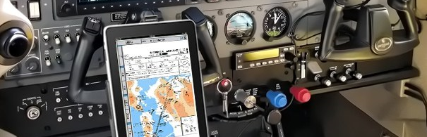
2017 was the safest year in aviation history

Slide 5
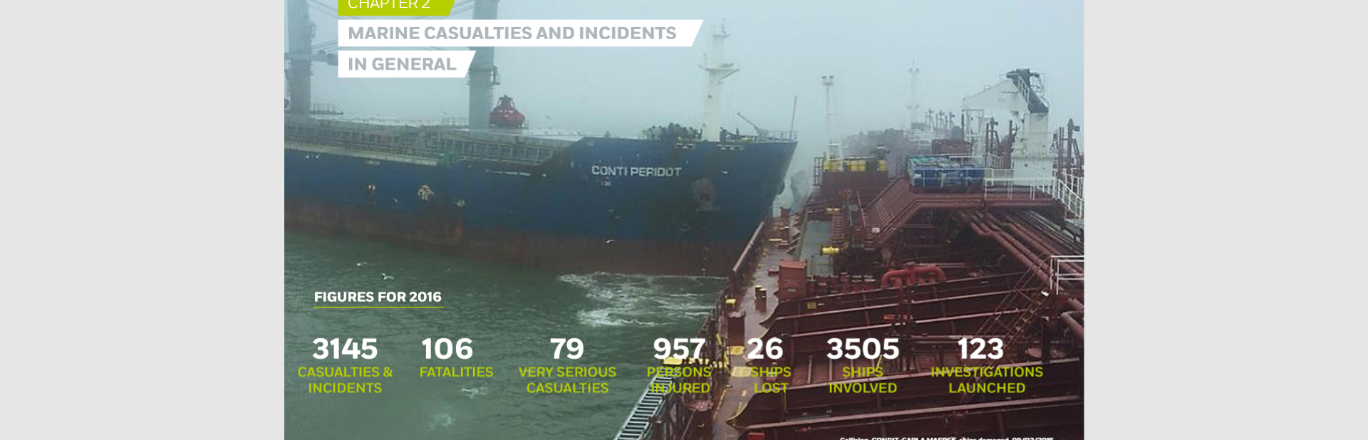
Ship accidents 2016 reported by EMSA

Slide 6
Back to basics
- returning to the simple and most important things
Find the business case
- a justification for a proposed project or undertaking on the basis of its expected commercial benefits
Look through the “Hype”
- promote or publicize (a product or idea) intensively, often exaggerating its benefits
... focusing on benefits and barriers when implementing e-Navigation technologies.

Slide 7
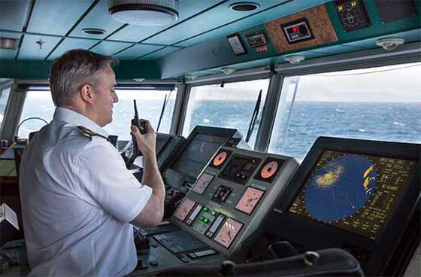
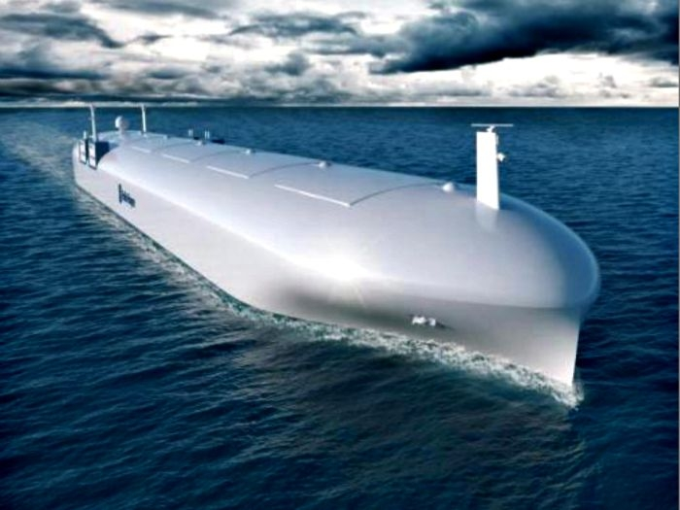

The difficult balance
Look out the window
Autonomous navigation

Slide 8
Back to basics
- returning to the simple and most important things
Find the business case
- a justification for a proposed project or undertaking on the basis of its expected commercial benefits
Look through the “Hype”
- promote or publicize (a product or idea) intensively, often exaggerating its benefits
... focusing on benefits and barriers when implementing e-Navigation technologies.

Slide 9
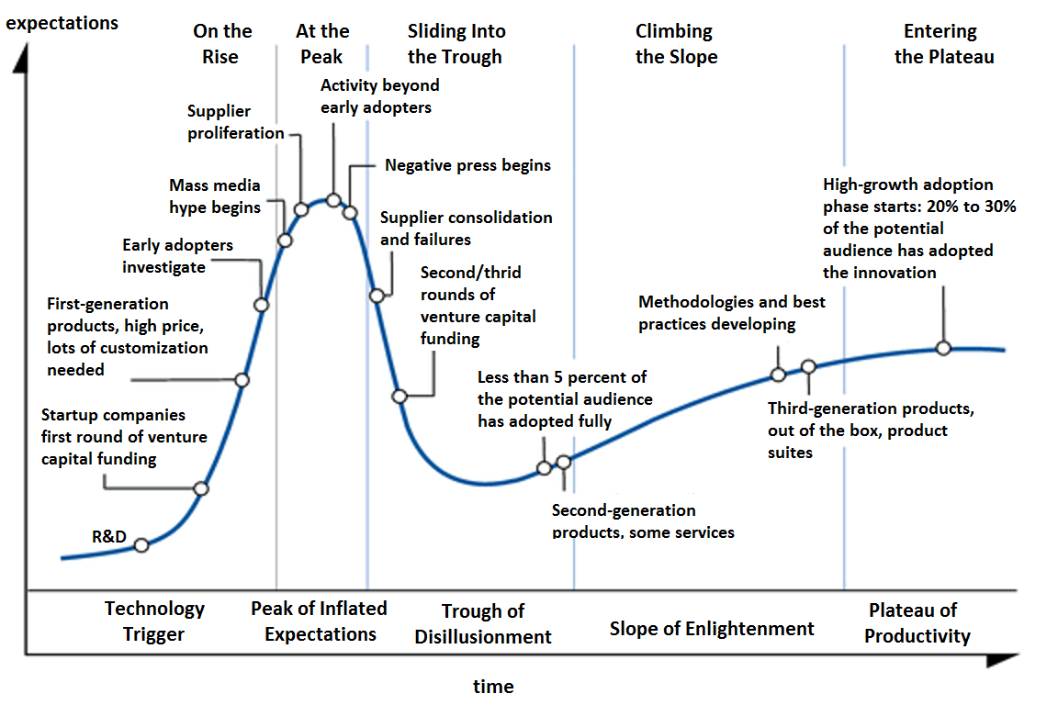
The hype cycle

Slide 10
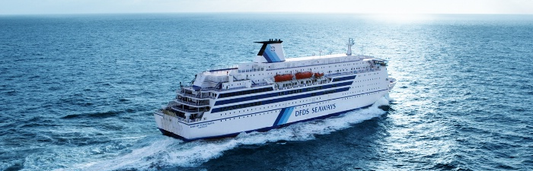
Thank you
… and enjoy the conference

Slide 11
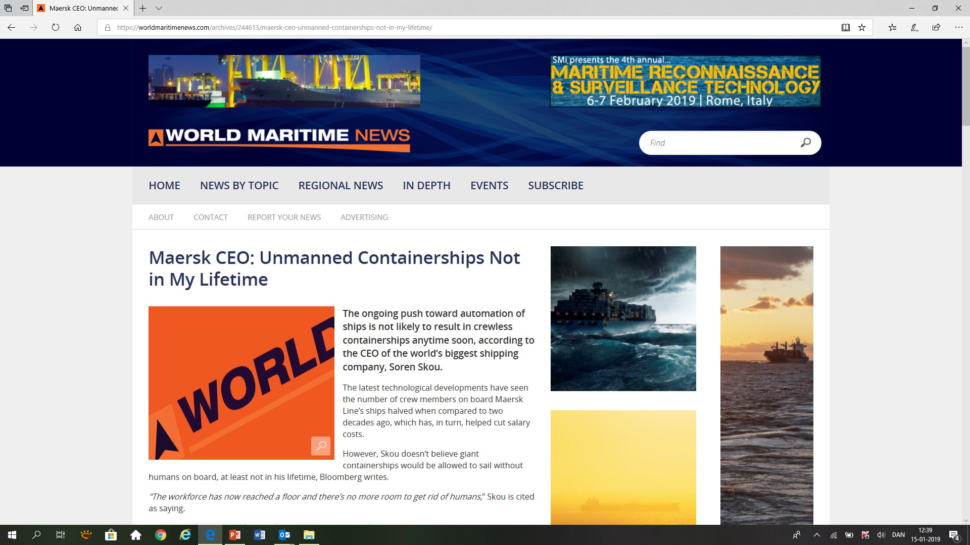
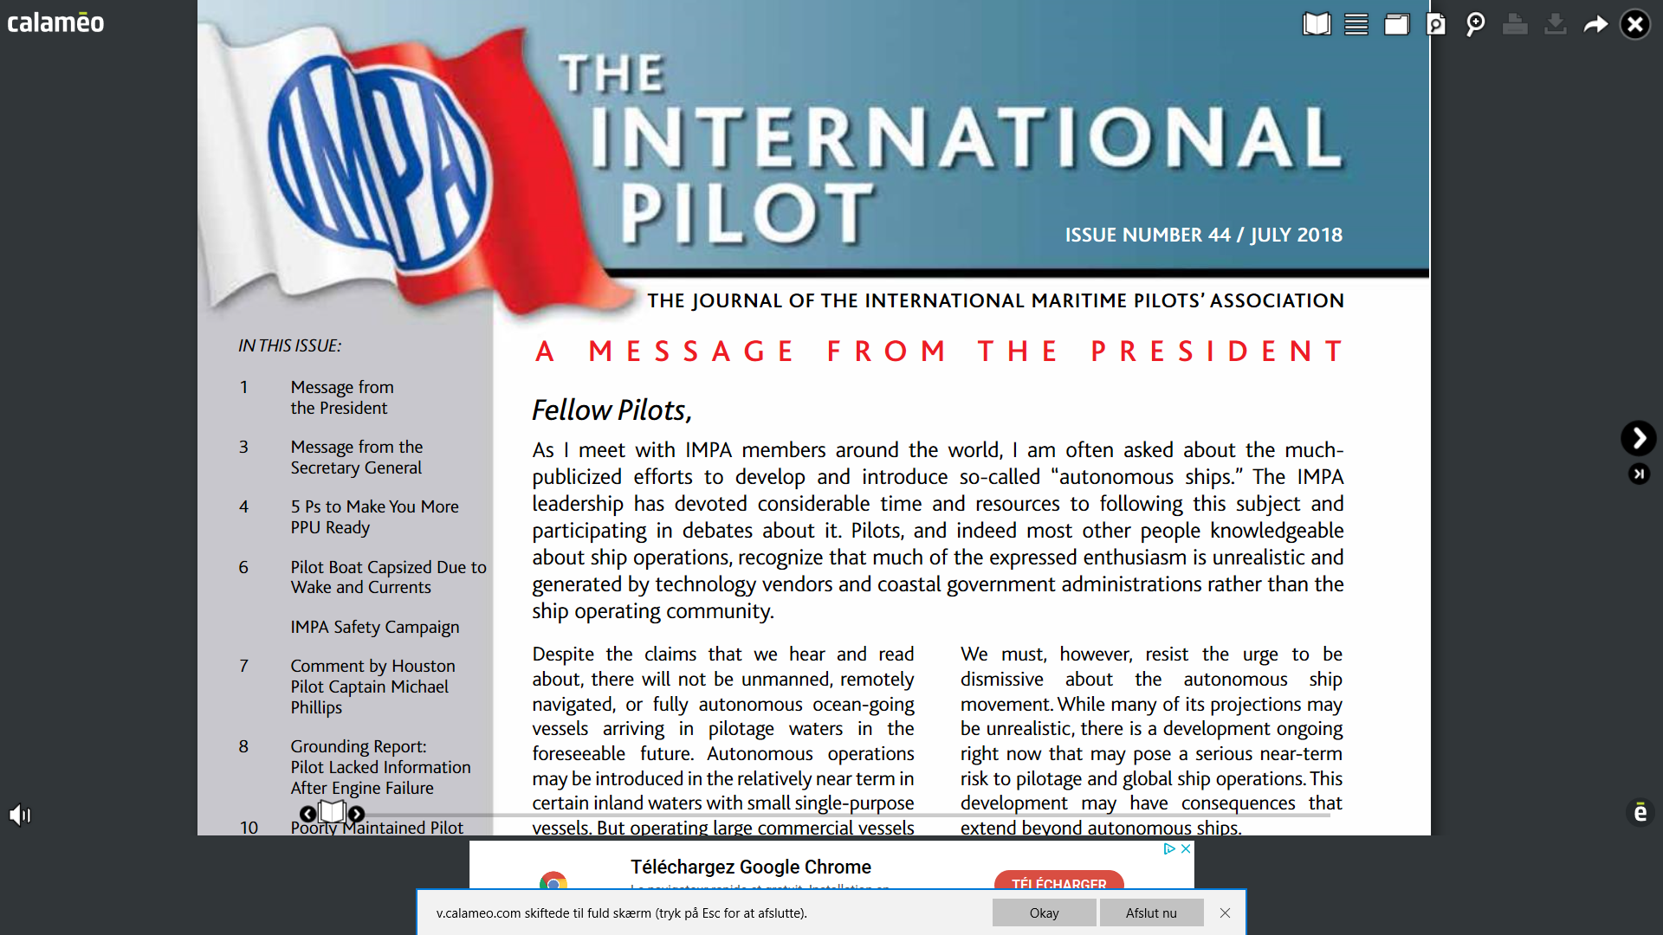
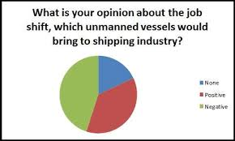
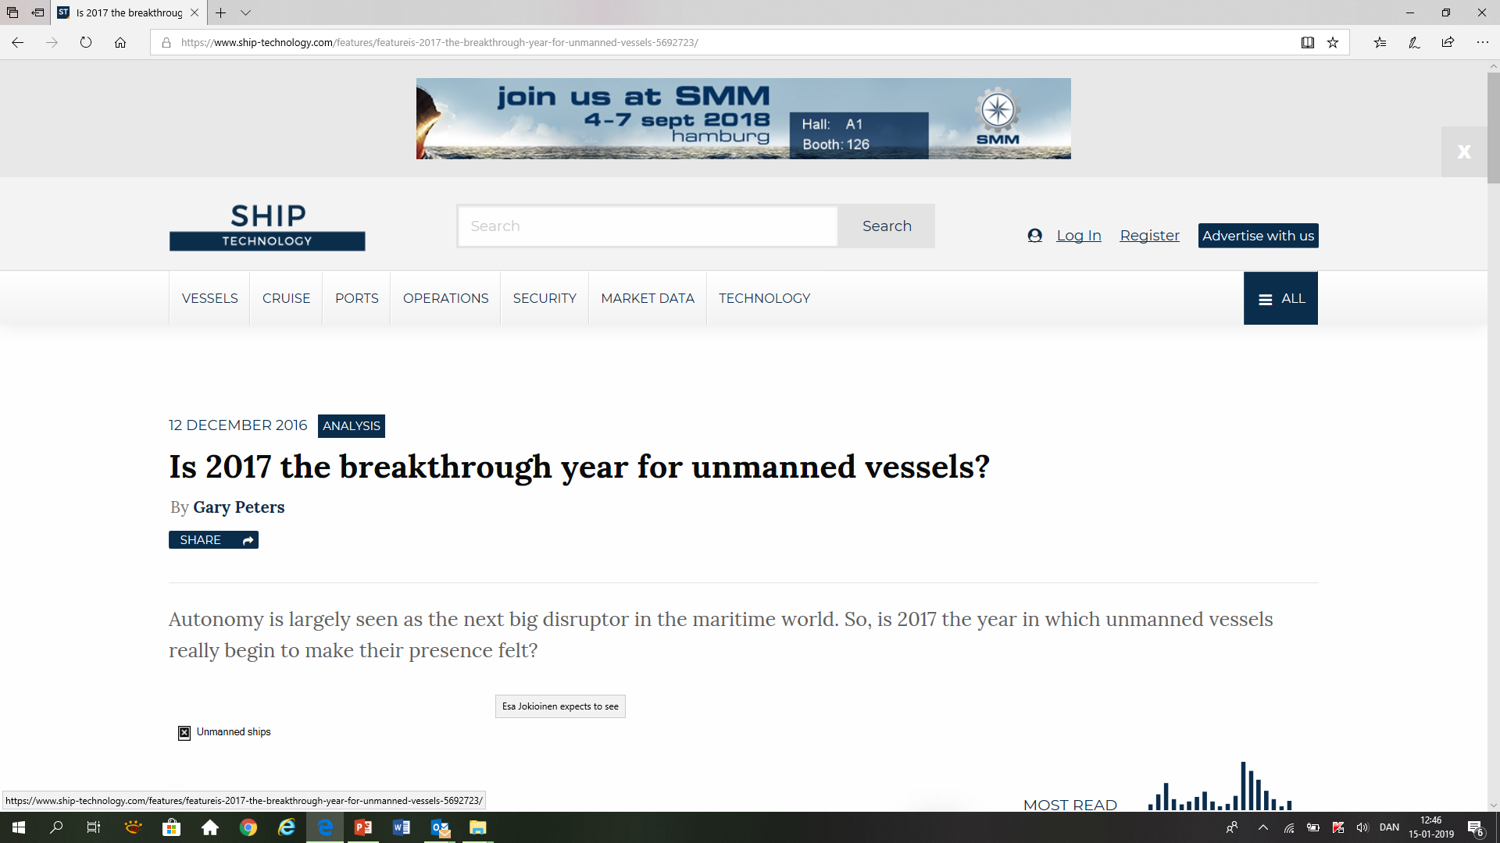
About so-called autonomous ships:
”Pilots, and indeed most other people
knowledgeable about ship operations,
recagnize that much of the expressed
enthusiasm is unrealistic and generated by
technology vendors and coastal government
administrations rather than the ship operating
community”

Slide 12


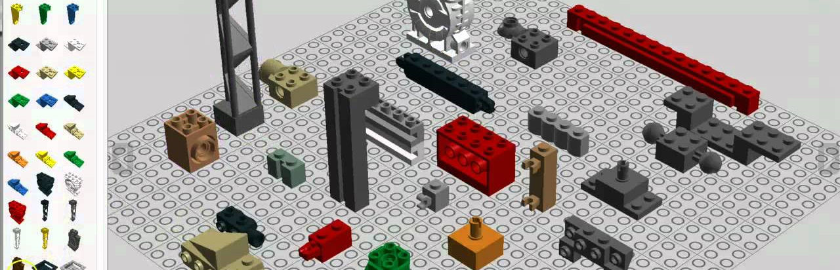
Focus on the basics

