Slide 1
The reality and future of e-Navigation
– Data exchange and collaboration inspired by aviation
Michael Bergmann
Research Institutes of Sweden (RISE)
BM Bergmann Marine
(michael.bergmann@bergmann-marine.com)

Slide 2
RISE Research Institutes of Sweden
non-profit research institute
information and communication technology for sustainable mobility:
cooperative systems
digital innovation
electromobility
sustainable business
sustainable transport
significant involvement in STM validation Project

Slide 3
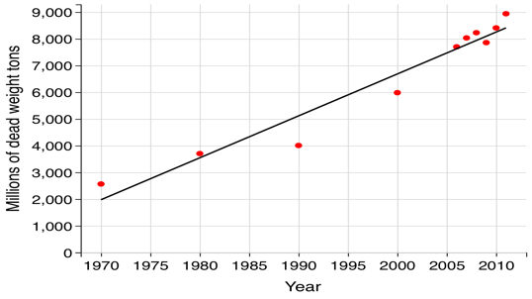
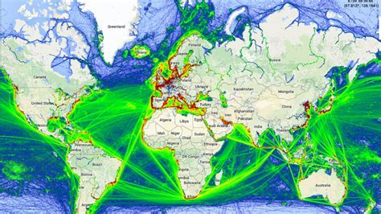
Digital opportunities in the maritime sector
Maritime transport is essential for the world economy
  Approximately 90% of the world’s trade carried by sea
  Economic impact of USD 436 billion
4.3% growth rate in 2012
2.7% of estimated global CO2 emissions in 2007
Will grow 2-3 times by 2050
DIGITIZATION IS
NEEDED TO COPE
WITH THE CHALLENGES

Slide 4
Need for Standardisation

Slide 5
How Standards fit
ECDIS, VTS, Routing service…
Applications
Need for
standards!
Interfaces
API aka technical service
Data and Information
RTZ, S-1xx,
S-211, S-421
Communication
TCP, IP, VDES, …

Slide 6
Need for data sharing

Slide 7
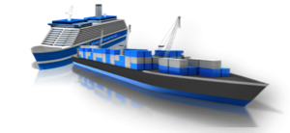

Collaboration is paramount
Ships
External
collaboration
Internal
collaboration
External
collaboration
Ports
External
collaboration
Hinterland
operators
Source: STM Validation Project 2018

Slide 8
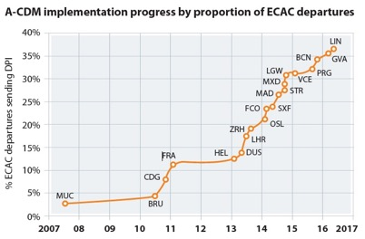
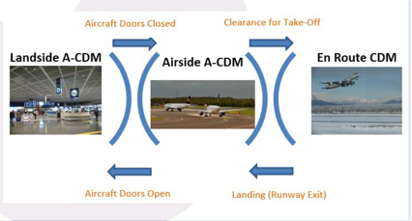
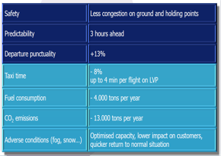
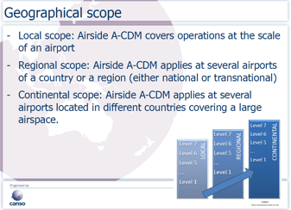
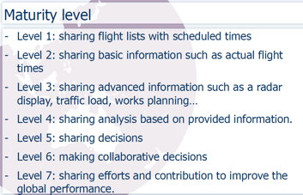
AIRPORT CDM
Source: FRAPORT - A-CDM Implementation Progress 2016
Source: Bastien Bernard A-CDM Subgroup CANSO
Source: Bastien Bernard A-CDM Subgroup CANSO

Slide 9

Port Collaborative Decision Making (PortCDM) – A-CDM inspired
keeping others in the maritime transportation chain informed about what is going on
PortCDM results in informed, collaborative and synchronized decision-making
- it is NOT group decision-making

Slide 10
Port Collaborative Decision Making (PortCDM) – A-CDM inspired
relies on sharing current, reliable, real-time progress and intentions data to optimize the transport supply chain
uses standardised, formatted, data sharing
data sharing in a digital world

Slide 11
Port Collaborative Decision Making (PortCDM) – A-CDM inspired
PortCDM promises decision-making that is
  better informed
  logical
  predictable
  effective

Slide 12
Integration of diversed data streams

Slide 13
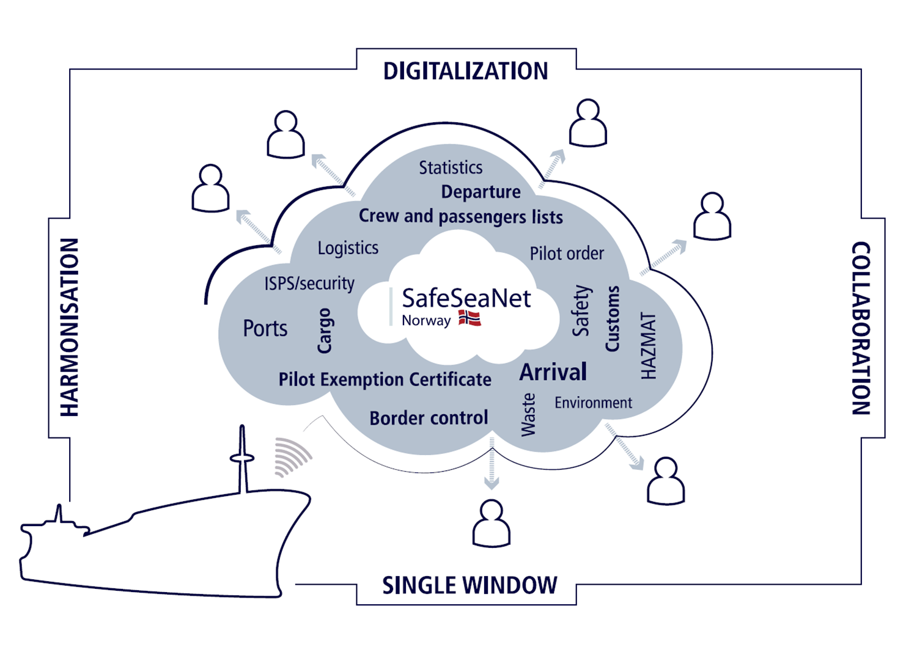
Digitization is broader
Various players work on digitization, data sharing and data integration
Systems need to handle all requirements
Navigational data may compete with other needs for information display
Standards need to define display priorities and interactions between data from different sources
Isolated standardization work will fail
IHO S-100 GI Registry may be able to support and facilitate this development
John Erik Hagen, Norwegian Coastal Administration, Copenhagen 24th January 2018

Slide 14
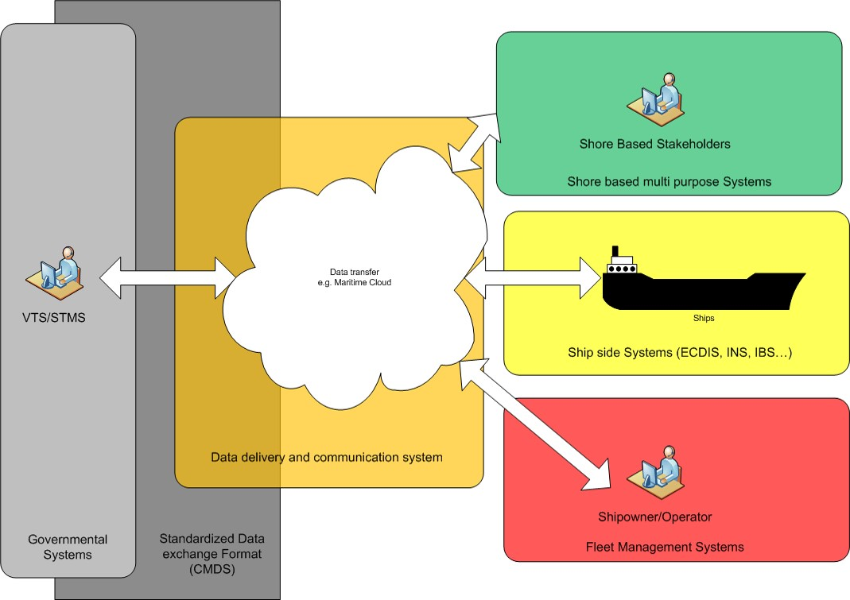
The CMDS Concept
Shore Based Stakeholder
Source: Robert Ward, E-Nav Underway Asia Pacific 2018

Slide 15
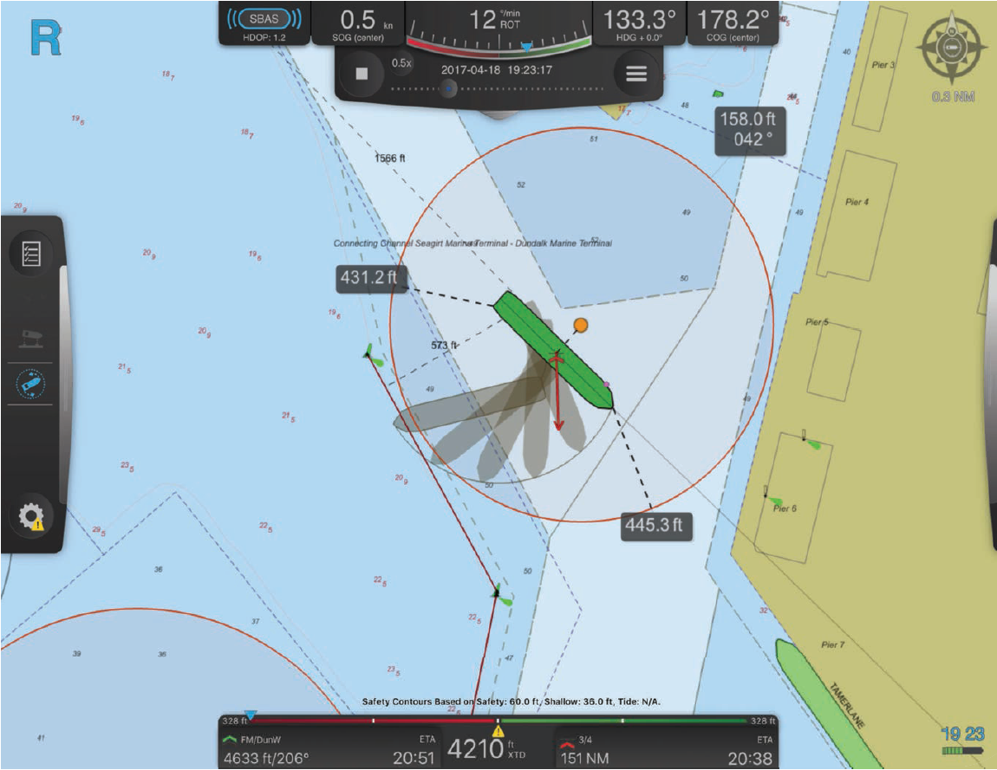
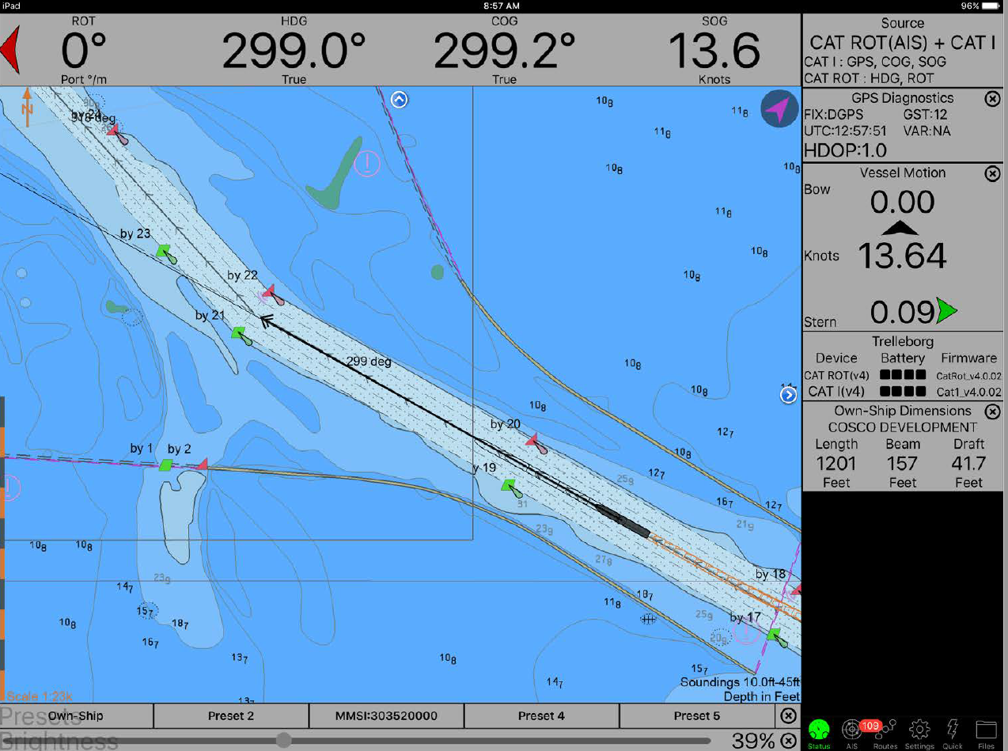
Examples of integrated displays
Source: Captain Jorge Viso, IMPA Conference 2018

Slide 16
Aviation Data Quality Standard DO-200/201
Accuracy
Resolution
Assurance Level
Traceability
Timeliness
Completeness
Format
Notes:
Accuracy
Accuracy is the degree of conformity of a measured or calculated quantity to its actual (true) value.
Resolution
Image resolution describes the detail an image holds. Higher resolution means more image detail. Image resolution can be measured in various ways. Basically, resolution quantifies how close lines can be to each other and still be visibly resolved.
Assurance Level
Critical
Catastrophic: Failure conditions that would prevent continued safe voyage.
Hazardous: Failure conditions that would reduce the capability of the ship or the ability of the crew to cope with adverse operating conditions to the
extent that there would be:
(1) a large reduction in safety margins or functional capabilities,
(2) physical distress or higher workload such that the crew could not be relied on to perform their tasks accurately or completely, or
(3) adverse effects on occupants including serious or potentially fatal injuries to a small number of those occupants.
Essential
Major: Failure conditions that would reduce the capability of the ship or the ability of the crew to cope with adverse operating conditions to the
extent that there would be, for example, a significant reduction in safety margins or functional capabilities, a significant increase in crew
workload or in conditions impairing crew efficiency, or discomfort to occupants, possibly including injuries
Minor: Failure conditions that would not significantly reduce ship safety, and that would involve crew actions that are well within their capabilities.
Minor failure conditions may include, for example, a slight reduction in safety margins or functional capabilities, a slight increase in crew
workload, such as routine voyage plan changes, or some inconvenience to occupants.
Routine
Failure conditions that do not affect the operational capability of the ship or increase crew workload.

Slide 17
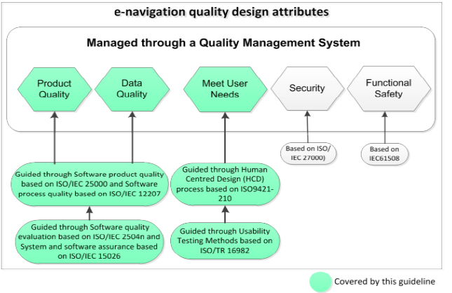
IMO HCD and SQA Guidelines
Source: Nick Lemon at e-Navigation Underway 2015

Slide 18
Data Supply Chain Certification (DSCC)
Guidance to ensure that:
  Source data integrity is not degraded
  Databases are compatible
  Databases are updated
  Includes all relevant processes and disciplines
  Recommended minimum standard
  Applicable to all phases of the maritime data process
Notes:
The integrity of the maritime authorities and the hydrographic offices created source data is not degraded.
The databases are compatible with the type of equipment that will use them.
The databases are updated in ways that ensure that the above remain current and valid.
Includes all processes involved in processing, controlling and loading of maritime data and databases.
Collection of disciplines necessary to provide assurance that the production of maritime databases meet the high integrity required for a safe trip.
Recommended minimum standard for the processing of maritime data.
Applicable to all phases of the maritime data process, from origination through acceptance and application by the end-user.

Slide 19
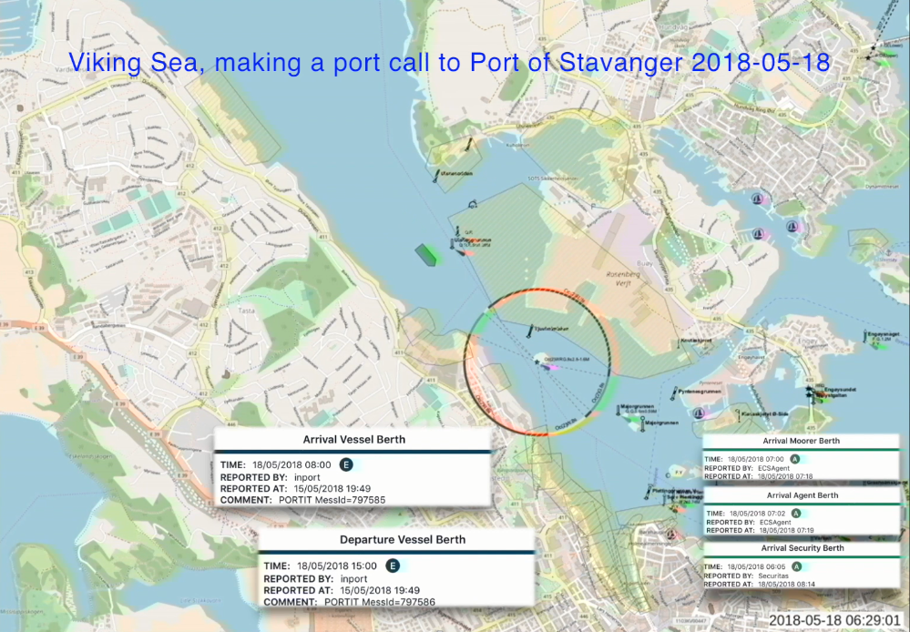

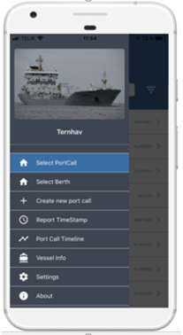
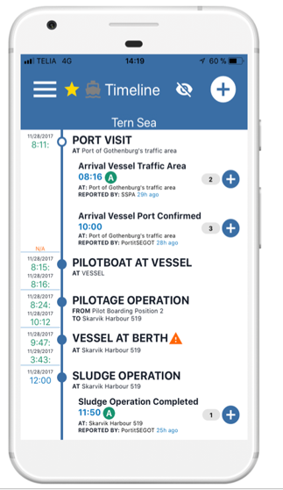


Validating the use of data integration and sharing
Notes:
Different initiatives have validated the concept of the definitions

Slide 20
None Navigation Example:
E-Certificates
Digital solution to gain mulity layer benefits

Slide 21

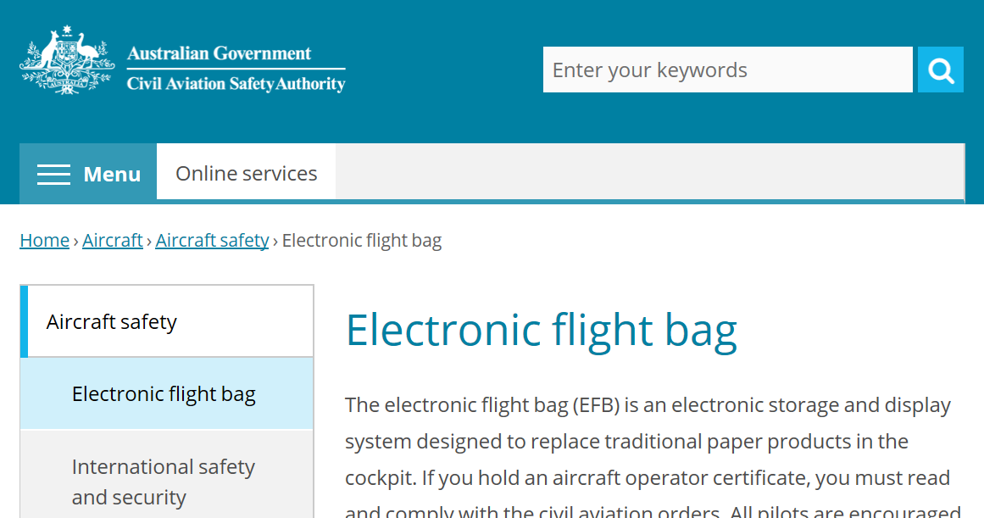
Electronic Certificates in Aviation

Slide 22
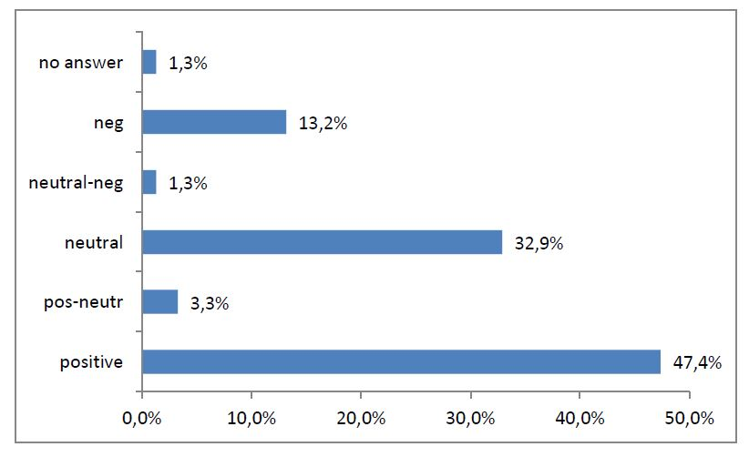
EU MONALISA Project 2012 ACTIVITY II report:
ATTITUDES TO AUTOMATIC REGISTRATION OF CERTIFICATES
Question:
What do you think of a potential system that will check in real time if a vessel is properly manned regarding certificates?
152 answered, active in shipping

Slide 23
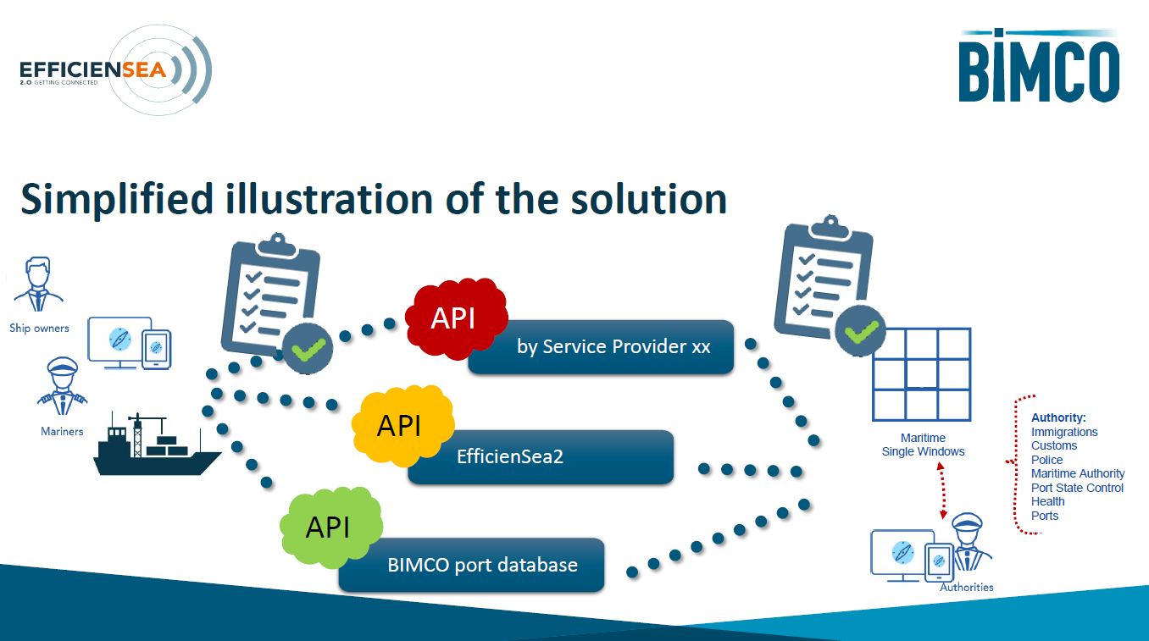

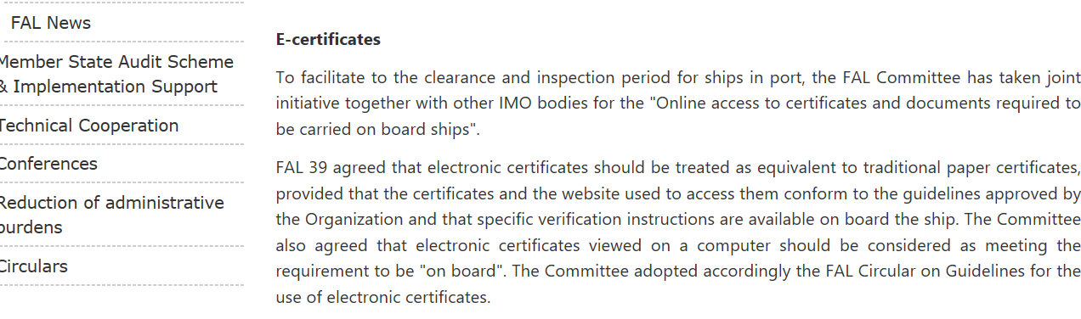
Maritime is waking up to e-Certificates

Slide 24
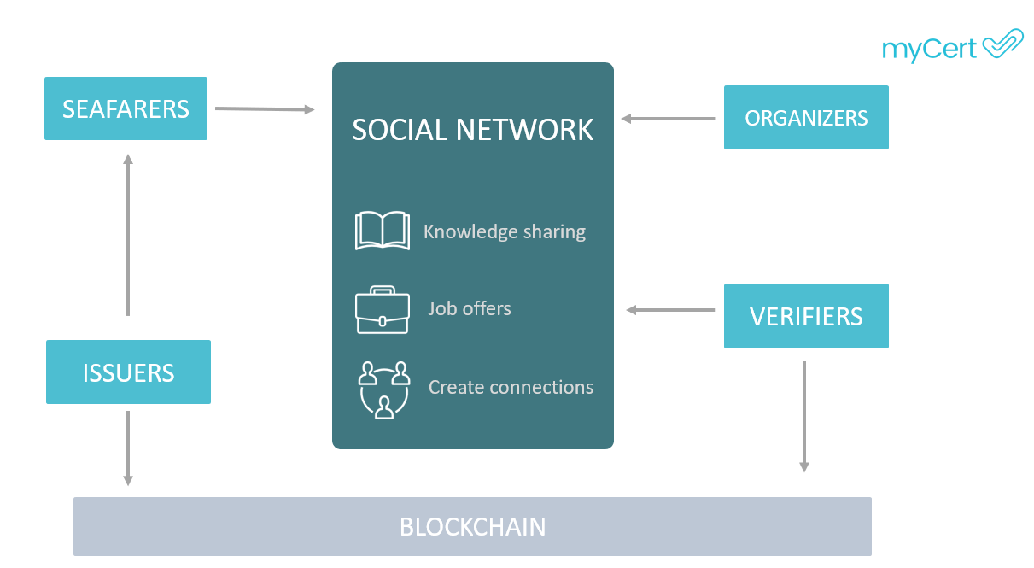
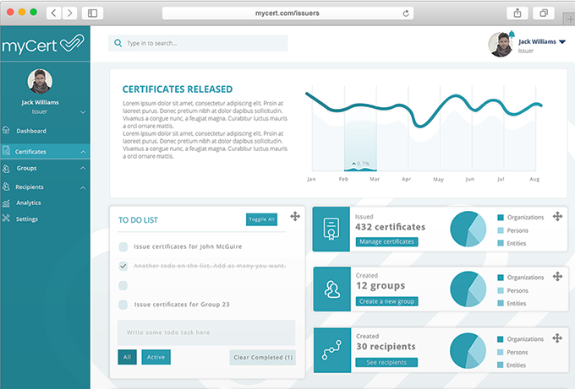
Example of existing e-Certificate solutions

Slide 25
Closing thoughts
Changes are coming on how information is shared and used
Developments on data integration and data sharing will impact in the short-term
Looking at individual data streams in isolation will be a thought of the past
Maritime can benefit from Aviation to support this paradigm shift
The situation is ripe for data sharing... Maritime domain need to act now!

Slide 26

Thank you
Michael Bergmann FRIN AFNI
michael.bergmann@bergmann-marine.com

