Slide 1
Harmonization is Key
Omar Frits Eriksson
Deputy Secretary General &
Dean of the World-Wide Academy

Slide 2
Harmonization is Key
Shipping is by its very nature mobile and global.
Shipowners may be willing to equip their new-buildings with state-of-the-art technology to maximize their competitive advantage and operational safety, but they are reluctant to spend money on multiple sets of equipment just because different regions of the world have developed their own digital solutions which are incompatible with each other.
Such incompatibility is a barrier to safe and sustainable global movement of vessels and will ultimately reduce the efficiency of the transport chain.
This is why we must harmonize the standards for digital solutions world-wide.
Indiustry is screaming for standards – IALA, IHO and IMO have the solution

Slide 3
IALA Maritime Buoyage System (MBS)

Slide 4
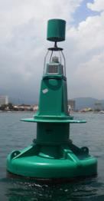
Lateral Marks
Denote the port and starboard sides of a channel
Check buoyage direction
Optional topmarks
Preferred channel marks with Composite Group Flashing lights (2+1) can be used where a channel divides
Can be synchronised
Buoyage direction
Region A Region B
Same can-shaped optional topmark
Region A lateral marks

Slide 5
Cardinal Marks – Both Regions
Named after the quadrant in which it is laid
Pass the mark on the named side
Must carry lights (Q/VQ; Q3; Q6; Q9) and topmarks
Used:
Indicate deepest water
Indicate safe side to pass
Draw attention to feature (e.g. channel bend or end of a shoal)
Note: too many Cardinal Marks in close proximity can confuse the mariner (IALA MBS 3.2.4)

Slide 6
Isolated Danger Mark
Built on or moored close to an isolated danger
Must have navigable water all round it
Pillar or spar buoy
Must carry topmark (2 black spheres one above the other)
Gp Fl 2 (Fl (2)) light (if lit)

Slide 7
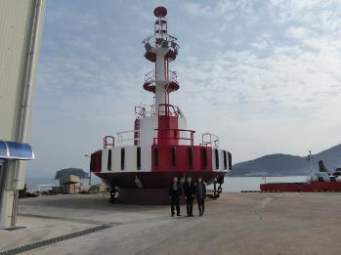
Safe Water Mark
Indicates navigable water all round
Used:
Fairway/landfall buoy
Centre line in TSS
Mid-channel marks
Top mark red sphere (optional)
Light
Isophase
Occulting
Long flash every 10 seconds
Morse “A”

Slide 8
Flash Characters
Long flash – more than 2 seconds duration
Single flash of about 1 second
Quick flash – period about once a second
Very quick flash – period about half a second
Isophase – equal light and dark
Occulting – more light than dark
Morse code character
Alternating colours
Fixed – not used

Slide 9
How was harmonization of the buoyage system achieved?

Slide 10
Four steps of harmonization
Define and publish the basic principles (technology agnostic and durable)
Provide guidance on how contemporary technologies can be utilized to apply the principles
Create a desire or an obligation to follow the principles
Publish how the principles have been implemented in any given geographical area
Notes:
In case of Aids to Navigation the benefits of harmonization were obvious to mariners who travel world-wide, and are constantly trying to find their way using all available information. Such a concept minimizes confusion and maximises the situational awareness of the navigator
In the case of e-Navigatio, the benefits are a bit more abstract, and seem to be difficult for navigatiorsto understand.

Slide 11
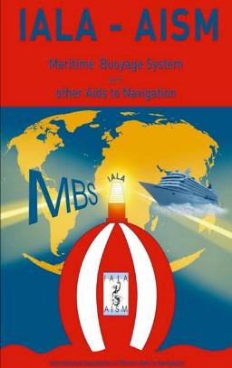
Four steps of harmonization
Define and publish the basic principles (technology agnostic and durable)
Notes:
In case of Aids to Navigation the benefits of harmonization were obvious to mariners who travel world-wide, and are constantly trying to find their way using all available information. Such a concept minimizes confusion and maximises the situational awareness of the navigator
In the case of e-Navigatio, the benefits are a bit more abstract, and seem to be difficult for navigatiorsto understand.

Slide 12
Four steps of harmonization
2. Provide guidance on how contemporary technologies can be utilized to apply the principles
IALA Guidelines (how to do it)
Ex: Incadescent lamps versus LED´s

Slide 13
Four steps of harmonization
3. Create a desire or an obligation to follow the principles
IALA Standards and Recommendations (what to do)
IMO - SOLAS Regulation 13 footnote

Slide 14
Four steps of harmonization
4. Publish how the principles have been implemented in any given geographical area
The Sea Chart (IHO)
Enables discovery/usage by seafarers

Slide 15
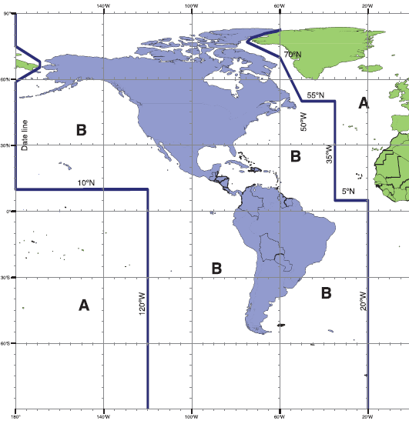
Global Harmonization (A & B)

Slide 16
MBS analogy in e-Navigation – digital services?
Define and publish the basic principles (technology agnostic and durable)
Notes:
In case of Aids to Navigation the benefits of harmonization were obvious to mariners who travel world-wide, and are constantly trying to find their way using all available information. Such a concept minimizes confusion and maximises the situational awareness of the navigator
In the case of e-Navigatio, the benefits are a bit more abstract, and seem to be difficult for navigatiorsto understand.

Slide 17
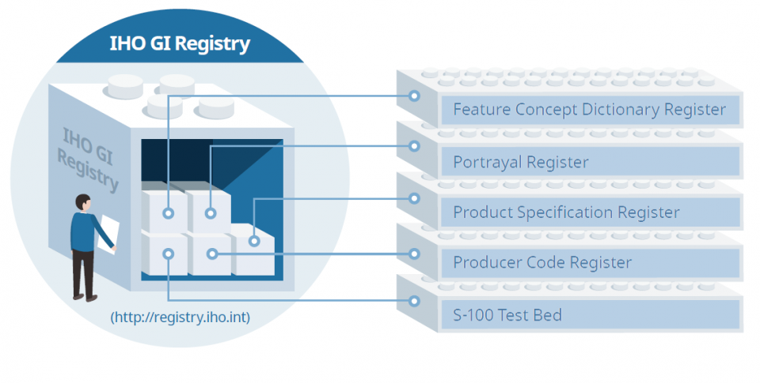
IHO S-100 Geospatial Information Registry
http://s100.iho.int/S100/productspecs

Slide 18
Five types of e-Navigation “specifications”
Maritime Service
Descriptions
S-100, S-200 …
Data Product
Specifications
Technical Service
Specification
Technical Service Design
Description
Technical Service Instance
Description
IMO
IHO (S-100)
IALA
IALA
IALA
IALA (S-200)

Slide 19
Five types of e-Nav “specifications/descriptions”
Maritime Service
Descriptions
S-100, S-200 …
Data Product
Specifications
Technical Service
Specification
Technical Service Design
Description
Technical Service Instance
Description
IMO
IHO (S-100)
IALA
IALA
IALA
IALA (S-200)
What to do
(IALA
Recommendations)
Technology Selection
How to do…
(IALA Guidelines)
(Blueprint)
Actual Implementation
(Sea Chart)
Basic Principles
Technology Agnostic

Slide 20
I am Tony I want to start my own business using e-Navigation principles

Slide 21
What type of business to select? - Tug service? - VTS service? - AtoN service? - Pizza service?

Slide 22
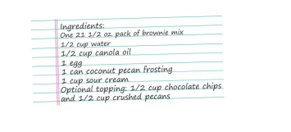
What type of producta should I offer? - Pizza Bolognese? - Pizza Diavolo? - Pepperoni Pizza (my mama´s recipe)

Slide 23
What is my Pizza service Concept? (technology agnostic) - Orders by telecommunication - Delivered to shipside - Within 17 minutes - Firmly packaged & still warm

Slide 24
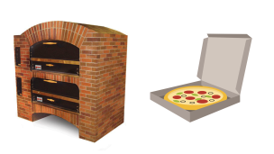
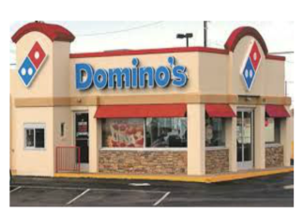
What technology and design? (Blueprint) - Stone furnace - Cardboard packaged - Delivered by Scooter - Pay by credit card - Domino´s look alike

Slide 25
I must advertise (Yellow Pages) - Establish Identity - Enable discovery - Publish endpoints - Conduct business

Slide 26
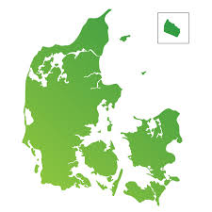
Now I have several instances

Slide 27
Four steps of harmonization
Define and publish the basic principles (technology agnostic and durable)
Provide guidance on how contemporary technologies can be utilized to apply the principles
Create a desire or an obligation to follow the principles
Publish how the principles have been implemented in any given geographical area

Slide 28
Global harmonized Connectivity requires more
5. Secure a share of our natural resources (frequency bandwith for digital channels)
Connectivity is the key enabler
Without harmonized world-wide interoperable connectivity solutions there is no e-Navigation
Notes:
In case of Aids to Navigation the benefits of harmonization were obvious to mariners who travel world-wide, and are constantly trying to find their way using all available information. Such a concept minimizes confusion and maximises the situational awareness of the navigator
In the case of e-Navigatio, the benefits are a bit more abstract, and seem to be difficult for navigatiorsto understand.

Slide 29
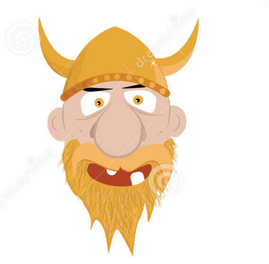
Projects - SESAME II You want to start your own business 23 mio. NO$ Open up – otherwise it is not e-Navigation

Slide 30
Connect:
E-mail: omar.eriksson@iala-aism.org
LinkedIn: Omar Frits Eriksson
Twitter: OMaritime
Mobile: +33 6 31 17 76 42

