Slide 1
E-navigation underway
6 – 8 February 2019
STM– testbed results, ongoing work and future developments
Notes:
Standard starting slide

Slide 2
Sea Traffic Management
Enable efficient exchange of information between maritime stakeholders through standards.
A decentralized service ecosystem for ships, ports and authorities.

Slide 3
STM Validation Project
Partnership: 39 partners from 13 countries
Total budget: appr.43 million Euro
EC contribution: 50%
Timeframe: 2015 – 2018 30 June 2019

Slide 4
What we set out do to
Validate the architecture of STM, usability of Maritime Connectivity Platform
Validate STM concept
Demonstrate the STM concept in
  Live test beds
  European Maritime Simulator Network

Slide 5








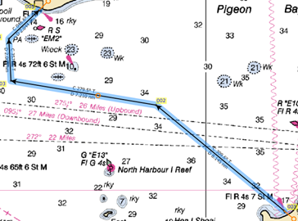









STM ports
Interoperable!

Slide 6
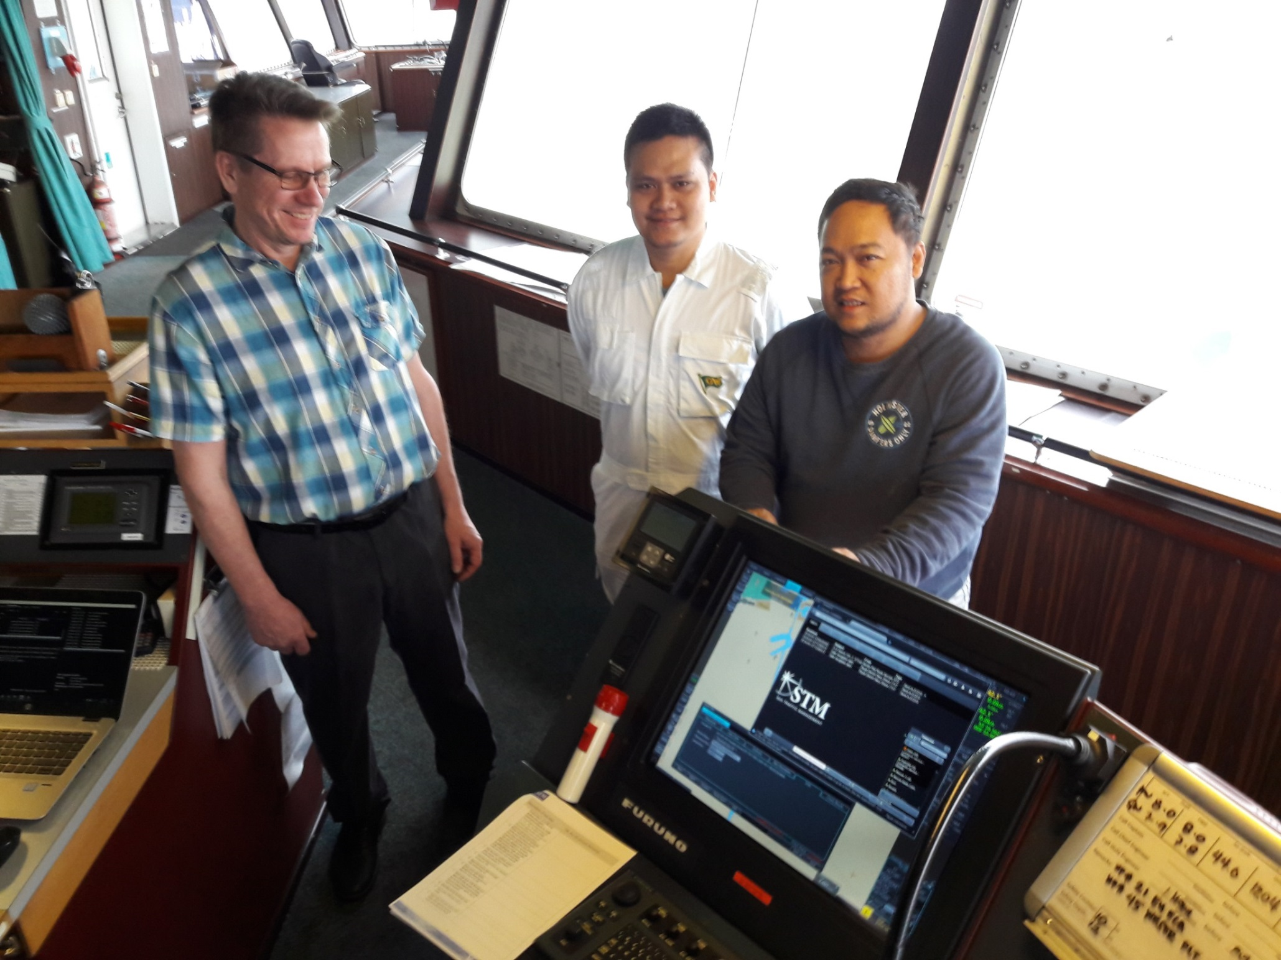

Slide 7
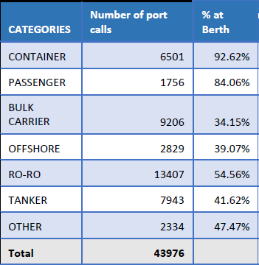
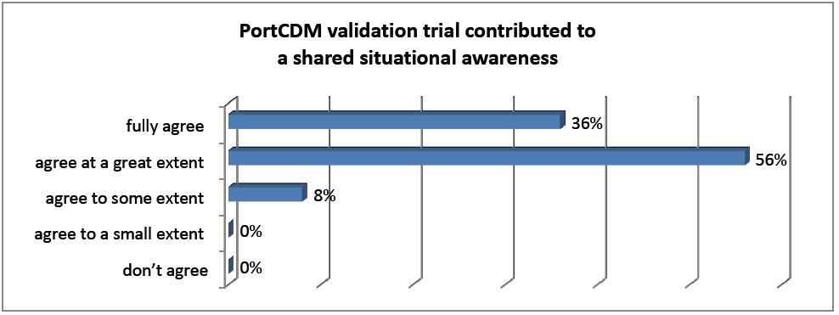
Project results - ports
Considerable waiting times verified
Example: 26% of total turnaround time
Inefficient information management
verified (duplicate, inconsistent, …)
STM in ports has the potential to
  Increase situational awareness (92%)
  Improve time
  estimates (72%)
  Give better access
  to information (68%)
Source: Port CDM validation report

Slide 8
Project results - ports
BUT…
A majority says the PortCDM demonstrator did not yet change their way of working.
For this, it is vital that
Functionality is built into regular systems
All actors participate

Slide 9
Project results - ships
Less VHF traffic with ship-to-ship route exchange (36%)
A potential for reduced number of accidents
BUT…
Uncertainties of limited liability (LLMC 1976)
Need to be accepted by shipping companies
Requires further studies
Sources: EMSN campaigns, Legal Aspects report, Training needs report.

Slide 10
Project results - VTS
“AIS is the biggest progress I have seen. STM will be the next.”
VTS Manager, Tarifa.
”Radar, AIS, STM. Those steps are equal in the history of VTS”
VTS Training Officer, Gothenburg.
Next: BaltSafe project: VTS in Sweden, Finland, Estonia
RFQ from India – route exchange with RTZ
LoI from Croatia – STM compatible for situational awareness

Slide 11
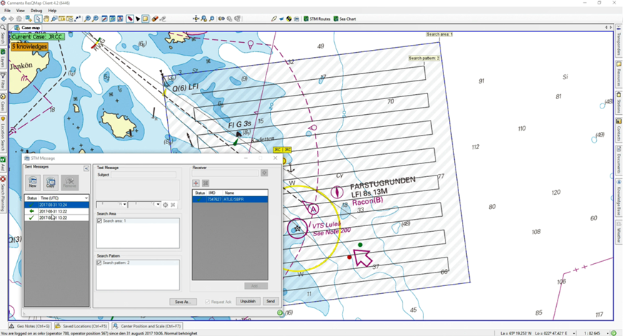
Project results – SAR
Less risk of misunderstanding
Reduced administrative load on SAR units
Potential for reduced response times
Introduced in Swedish
SAR system
Source: EMSN SAR campaigns

Slide 12
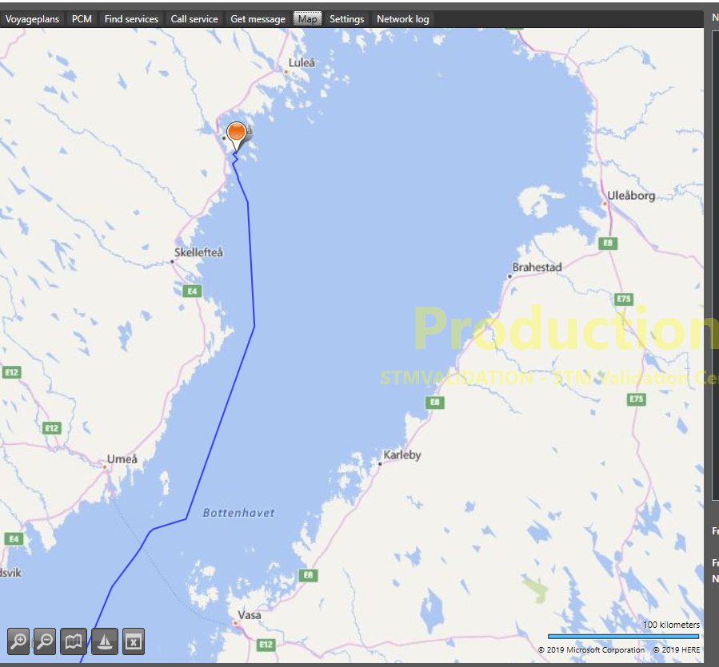
Project results – Icebreaking
Swedish and Finnish
icebreaker management
system IBNet
First live interactions
Interoperable with
regular (STM) ships
Original voyage plan→

Slide 13
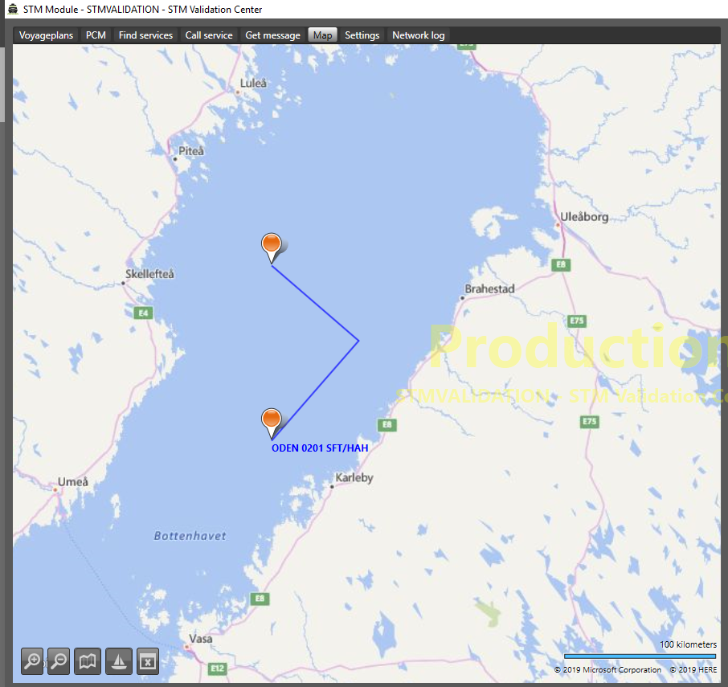
Project results – Icebreaking
Swedish and Finnish
icebreaker management
system IBNet
First live interactions
Interoperable with
regular (STM) ships
Icebreaker dirway→

Slide 14
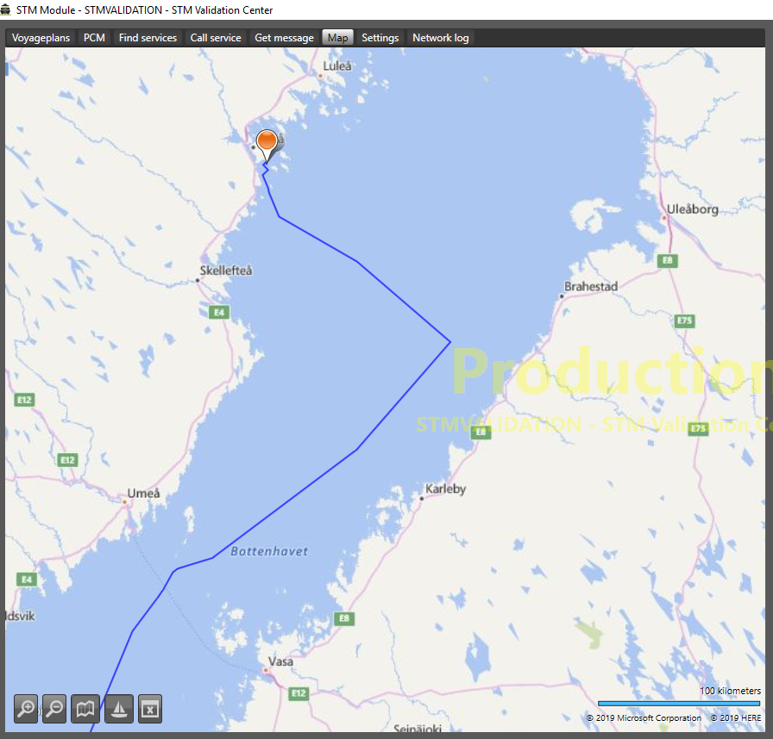
Project results – Icebreaking
Swedish and Finnish
icebreaker management
system IBNet
First live interactions
Interoperable with
regular (STM) ships
Updated voyage plan→

Slide 15
…and these are also project results
BIMCO STM clause
Engaging in the MCP consortium
Inspiring the STM industry group
Interoperable projects
  BaltSafe
  EfficientFlow
  Ports of Call – awaiting evaluation
SMART Navigation and SESAME II interoperability

Slide 16
Thank you!
Per Setterberg
Swedish Maritime Administration
Operational Project Manager
STM Validation Project
Notes:
At the end – you could add text in black like ”Thank You !”

