Slide 1
EMSA’s challenges for implementing e-Navigation with new technologies
Session 3: The Port and Coastal State
Leendert Bal
Head of Operations
E-Navigation Underway 2019, 6-8 February 2019

Slide 2
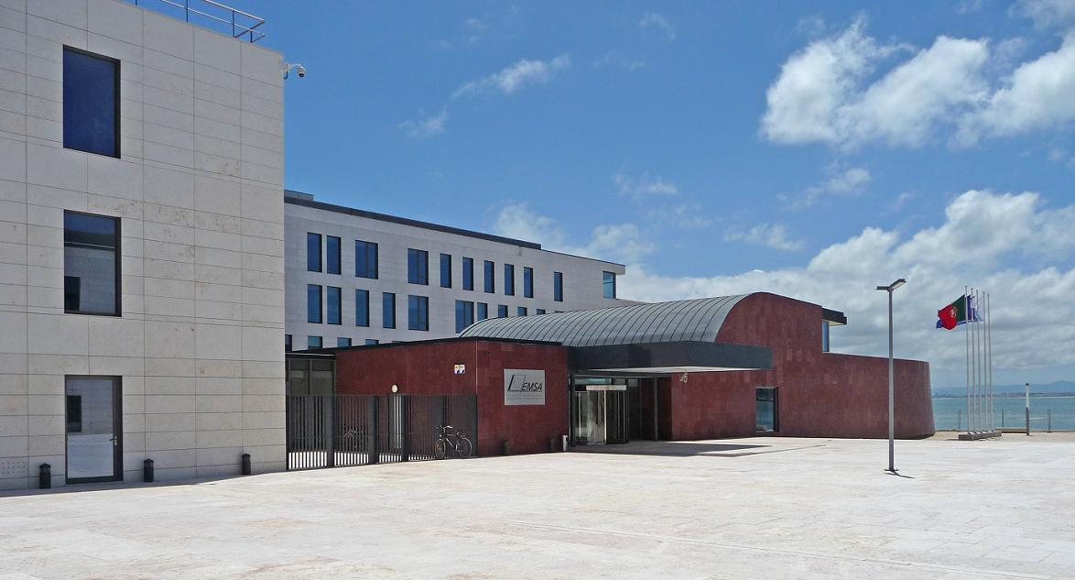
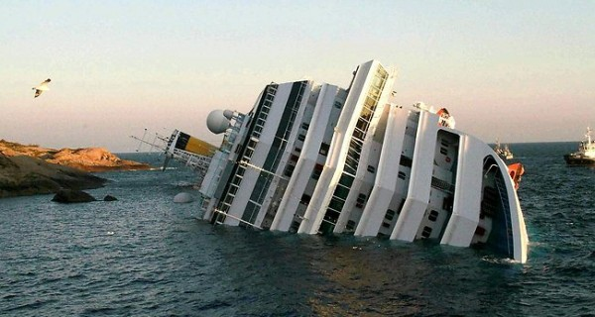
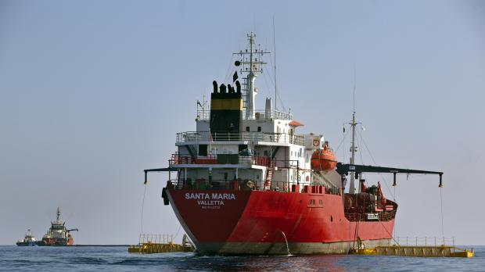
European Maritime Safety Agency
Regulatory Agency of the European Union
Own legal identity
Maritime safety, security, prevention and response to marine pollution by ships, oil and gas installations
Technical and operational support to EU Member States and Commission
~250 staff,
24 nationalities
~100 staff in Operations Department
Annual overall budget:
~80 million Euros
HQ Lisbon, Portugal

Slide 3
General presentation
SafeSeaNet is a European Platform for Maritime Data Exchange developed in accordance with Directive 2002/59/EC
The exchange of vessel, voyage and other information via SSN supports users at EU and MS level in the:
    efficient and timely response to incidents or pollution at sea, including search and rescue;
    monitoring of ships that pose a potential risk to the safety of shipping and the environment, including those involved in incidents;
    effective collection of information to support inspections, safety and security;
    efficient management of port traffic.

Slide 4




SafeSeaNet – Information exchanged
Port A
(Non EU)
PortPlus message
HAZMAT (DG, POB…)
Arrival (ATA)
Pre-arrival 72/24 hrs (ETA, Port of Call, POB…)
Departure (ATD)
Exemptions for
24h Pre-arrival
Hazmat
Pre-arrival Security
Pre-arrival Waste
Bunkers
x
Waste
Security
AIS track
x
x
Ship report
AIS/MRS
ID, POB, Position…
Incident/accident
POLREP
SITREP
Lost&Found Objects
Waste
Other …
Port B (EU)
MRS type etc.

Slide 5
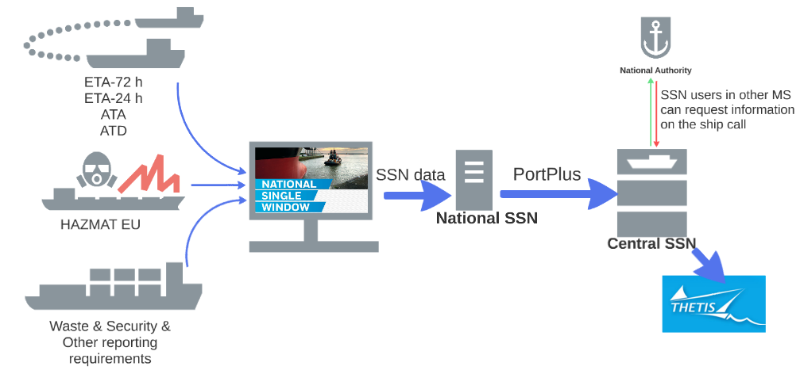
Link NSW with national and central SSN

Slide 6
EMSA’s activities on VDES
VDES: facilitating digital data exchange using VHF;
Providing support to the European Commission and Member States on matters related to VDES (i.e. at IMO on EU coordinated position on VDES for WRC 19);
Collaborating further with ESA on VDES following the successful joint ESA-EMSA SAT-AIS initiative;
Expanded the remit of the EU SAT-AIS Collaborative Forum (EMSA Chairs) also to cover VDES;
Sees huge potential for VDES (VDES-SAT) particularly in providing the means to enable a ship to transmit and receive data packages to and from the National Single Windows (NSW) which were set up for implementing Directive 2010/65/EU;
Teamed up with ESA and Norway for a VDE-SAT demonstration activity, presently under preparation.

Slide 7
VDE-SAT demonstration - exchange of Reporting Formalities
Scope: to simplify and harmonise the administrative procedures applied to maritime transport in order to reduce the administrative burdens for shipping companies. It proposes to do this by:
making the electronic transmission of information standard;
rationalising reporting formalities through simplification and harmonisation;
transmitting formalities electronically through a National Single Window (NSW) system;
submitting information only once on a pre-arrival/departure basis.
Directive 2010/65/EU of the European Parliament and of the Council of 20 October 2010
To facilitate maritime transport the EU Member States adopted on reporting formalities for ships arriving in and/or departing from ports of the Member States

Slide 8
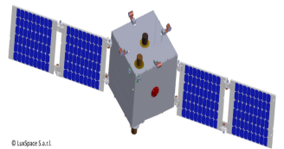
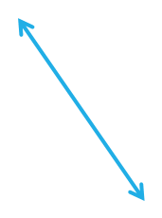
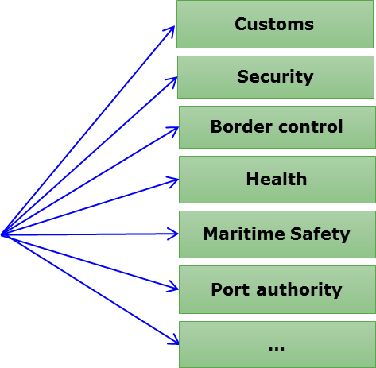

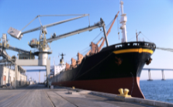
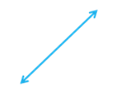

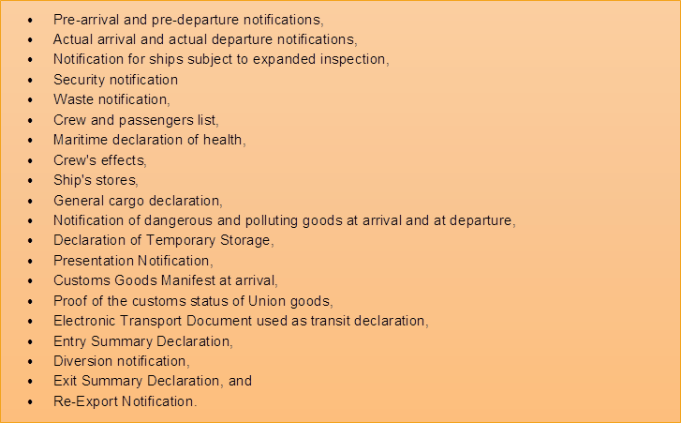
VDES Application - exchange of reporting formalities for ships arriving in and departing from ports
A holistic view of a potential set-up
Notifications/ high rate digital data packages
XML
VDES service provider/s ground segment
NSW
On-board application
Reporting Gateway at EMSA
NSW
etc.
Satellite based front-end solution respecting existing national NSW systems
Examples of data packages transmitted by ships to be handled by the EMSA Reporting Gateway

Slide 9
Other potential areas EMSA is considering for using its Reporting Gateway for VDES services
Maritime Safety Information
SAR Communication
Meteorological information service
Ship Reporting
Vessel Traffic Services
Route Exchange
Charts and Publications
Voyage Plans for MASS operations
Search and Rescue related information and coordination
Real time hydrographic and environmental information
Exchange of VTS information
Nautical charts

Slide 10
Maritime Autonomous Surface Ships (MASS)
Digitalization is fundamentally changing the working environment not only ashore but also at sea
There is a growing interest in autonomous and remotely-controlled ships
IMO has started to work on how to ensure safe, secure and environmentally sound MASS operations.
The European Commission has started to look into MASS, and DG MOVE held the first meeting of the HLSG ad hoc expert sub-group on MASS on 9 October 2018.

Slide 11
HLSG ad hoc expert sub-group on MASS - highlights
The EC’s High level Steering Group (HLSG) for the Governance of the Digital Maritime System and Services is:
investigating the VTMIS aspects (VTS angle) related to the introduction of autonomous navigation;
analysing how to deal with autonomous navigation and routing from the perspective of monitoring, management and control.
MSs have expressed their wish for EMSA to extend its Integrated Maritime Service (IMS) also to cover MASS operations.
Present focus/demand is on automation/autonomous vessels/MASS and none or little was found to be focusing on the VTS aspects.
Mixed/hybrid traffic will become a key issue to address.
VDES and SAT technology are seen as a possible solution to manage safety of navigation.
Cyber threats / cyber security need to be seriously considered given the substantial risk involved when conducting MASS operations.
.

Slide 12
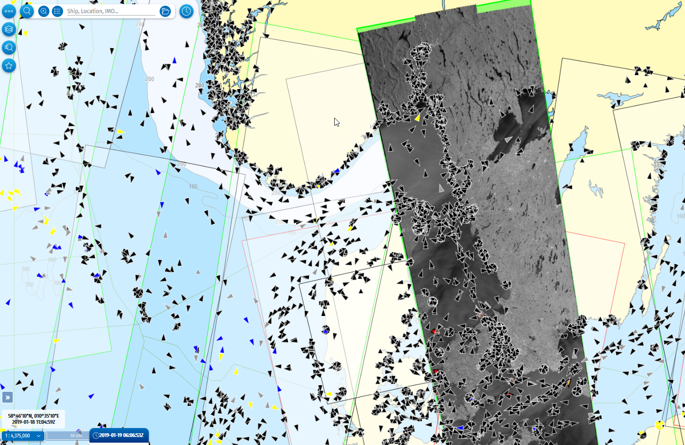
Integrated Maritime Services (IMS)
T-AIS (black)
S-AIS (blue)
LRIT (grey)
VMS (yellow)
MRS (brown)
EO
Detected vessels (red)
Notes:
The idea of a European Maritime Safety Agency (EMSA) originated in the late 1990s along with a number of other important European maritime safety initiatives. EMSA was set up as the regulatory agency that would provide a major source of support to the
Commission and the Member States in the field of maritime safety and prevention of pollution from ships. The Agency was established by Regulation (EC) 1406/2002 and subsequent amendments have refined and enlarged its mandate Post Erika 2002: EMSA established The European Maritime Safety Agency has been established for the purpose of ensuring a high, uniform and effective level of maritime safety, maritime security, prevention of, and response to, pollution caused by ships as well as response to marine pollution caused by oil and gas installations.
Post Prestige 2004: New task: Marine Pollution Response
Budget: approx. 50 MEUR, Pollution response task: 18 MEUR

Slide 13
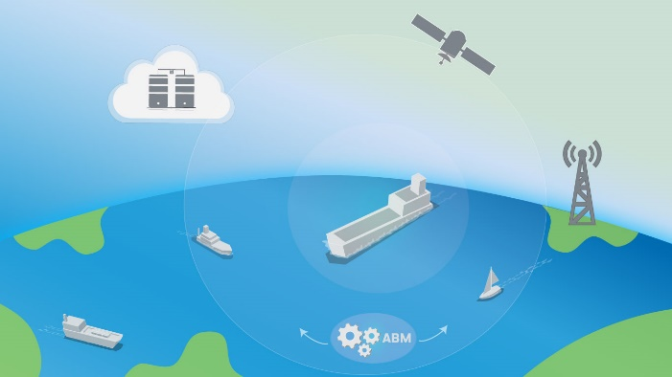
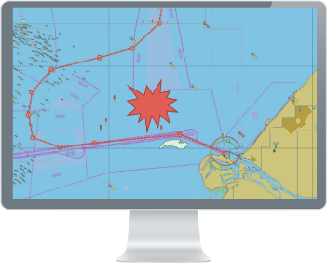
Towards an IMS MASS situational awareness service ?
EMSA could assist in facilitating vessel traffic services in areas where there is a MASS operation taking place.
1) The moving zone/area around the selected ship will be used to trigger a warning to the IMS user.
2) IMS Automated Behaviour Monitoring (ABM) tool will identify ships in the vicinity of a MASS operation.
Ships in the immediate vicinity of a MASS operation will receive a warning/ information about the MASS’s presence. How to do it?
An EMSA MASS situational awareness service will improve the maritime situational awareness for ships operating in the vicinity of MASS operations.

Slide 14
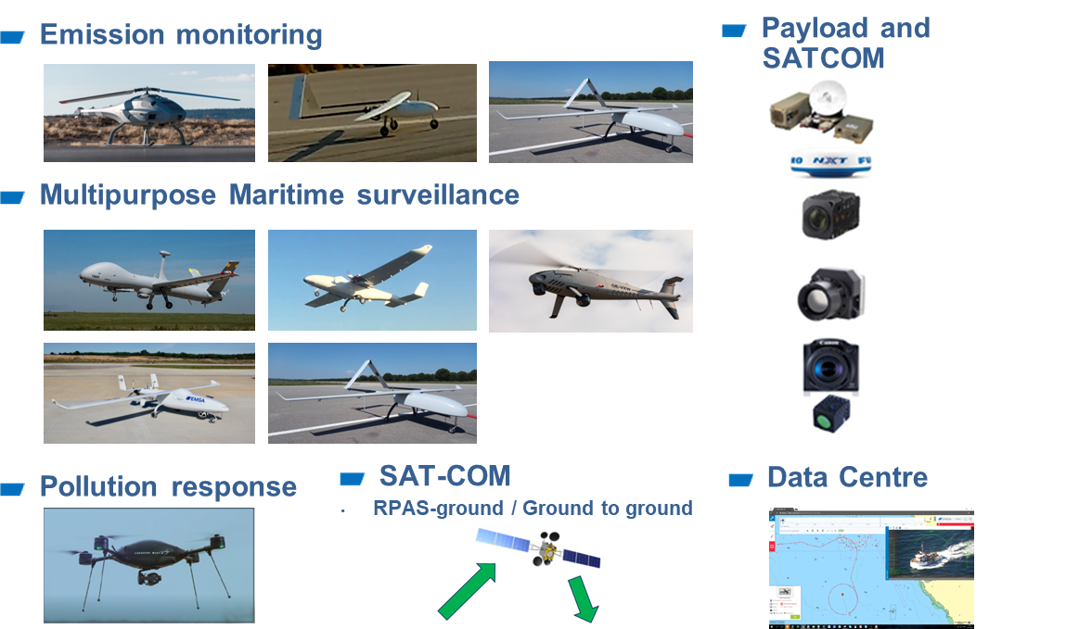
Operational RPAS services contracted

Slide 15
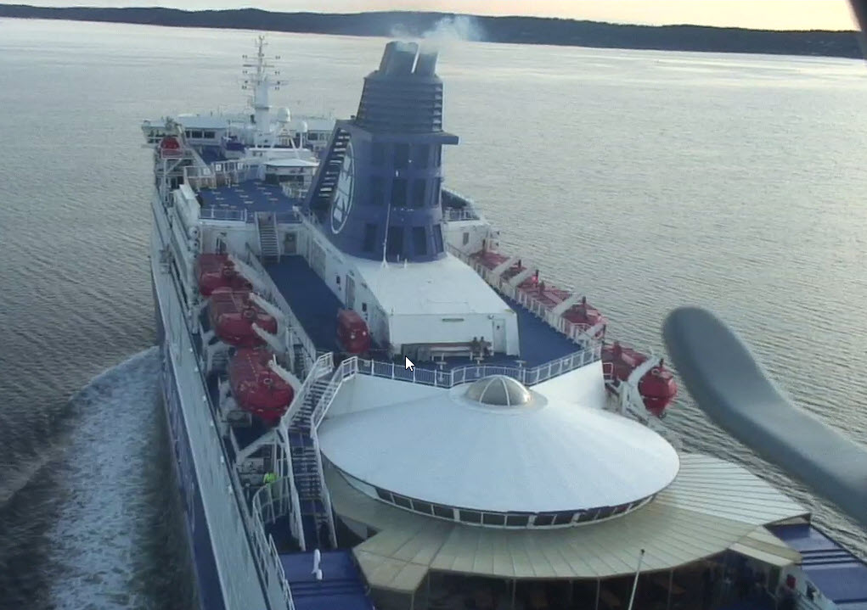
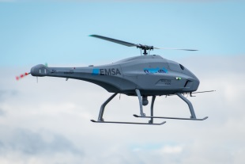
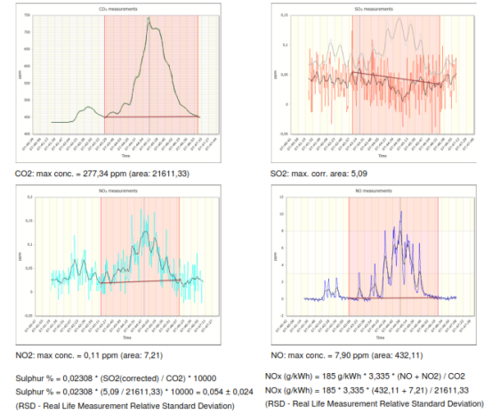
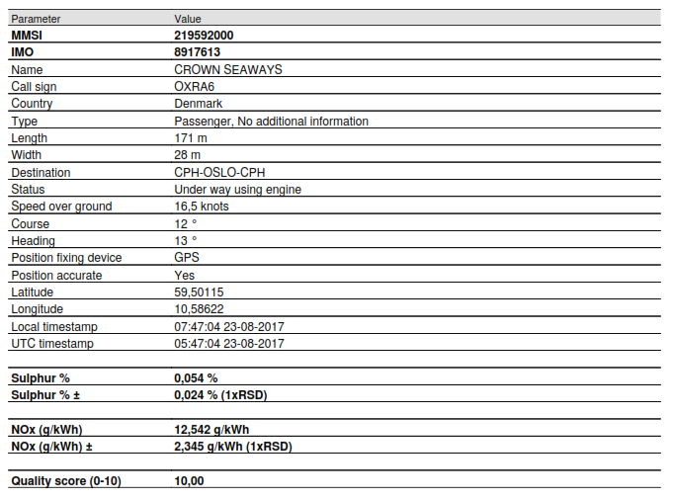
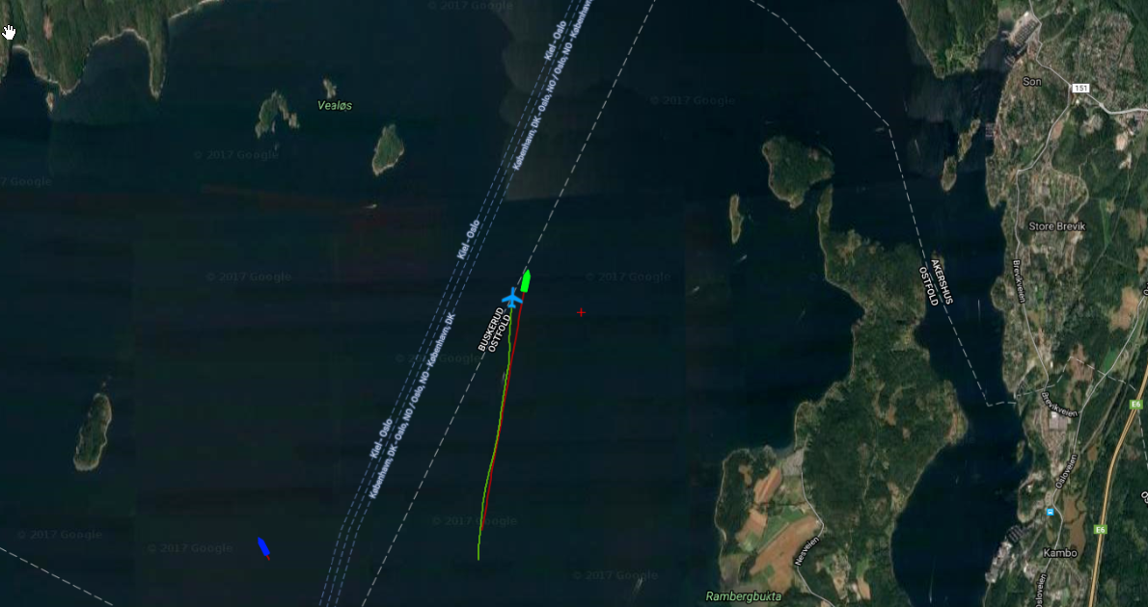
Emission monitoring
Monitoring
Emission monitoring (over the plume)
Emissions Report and Charts (Sulphur and NOx)
Vessel and RPAS track (23 Aug 2017)
New deployments start in 2019: Denmark (April), France, Greece

Slide 16
Using cloud technology
Moving from data management to information management:
Bringing more intelligence to the maritime picture (ABM – MASS), more flexibility (RPAS)
Reporting Gateway (VDES) in the cloud can offer many services
Cloud used for large scale applications:
  THETIS MRV for CO2 calculations by the industry
  Public version of SafeSeaNet (open data)
  E-Certificates and other digitalised services
Initiatives are fragmented (many small clouds), do EU Member States want more horizontal solutions for a “Maritime Cloud” in Europe?

Slide 17
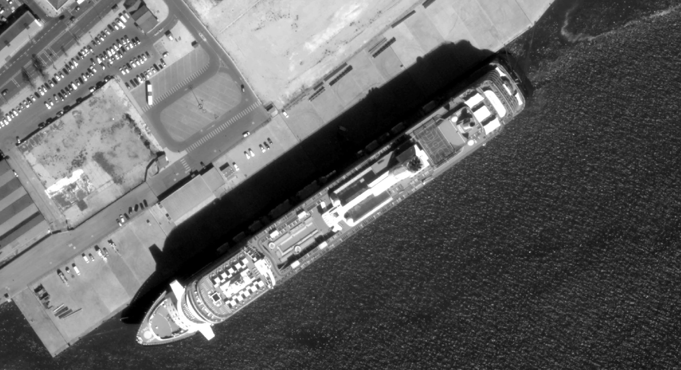
Image credit: European Space Imaging/DigitalGlobe 2015
Visit us: copernicus.eu
emsa.europa.eu

Slide 18
SafeSeaNet – Information relevant for Ports
Information declared on departure from last port:
Early information on the possible next port of call and ETA
Confirmation of ship departure (ATD) and POB (number of persons on board)
Hazmat information (dangerous and polluting goods on board)
Notification of waste and residues, including quantities retained on board for discharge at next port
Confirmation of Ship security level at previous port
Bunkers on board
Ship historical information:
Previous ship calls
Previous waste notifications to compare quantities of waste discharged
Previous security notifications to compare last 10 ports of call
Information from Ship MRS reports:
Early information on the possible next port of call and ETA
Indication of dangerous and polluting goods on board
POB (number of persons on board)

