Slide 1
Drones – an aid to increased Situational Awareness in pilotage operations
VesCo Systems, Remote Pilot supported by the Danish Maritime Fond

Slide 2
Roadmap of this presentation
The Vision for the use of Drones
The process of using new technologies
Graduating Situational awareness
How far have we come?
Thoughts and visualization
COWI report 2014
Vision for shore based pilotage
Piloting as a control problem
Who are VesCo Systems
Redundancy and stability
Will the ships buy shore based pilotage?

Slide 3
The Vision for the use of Drones
VesCo Systems – a joint venture between:
Blue Oceans Robotics
Third Element Aviation
DanPilot
Supported by the Danish Maritime Fond

Slide 4
The Vision for the use of Drones
COWI concluded in 2014 that the best potential for shore based pilotage would be for sea pilotage relating to specific areas in Danish waters based on safety assessment
Safety assessment of shore based pilotage in the three scenarios
Source: COWI, November 2014, DMA. Technological Assessment ofthe possibility of shore based pilotage in Danish Waters.

Slide 5
The Vision for the use of Drones
”If everything else remains unchanged remote pilotage will always lead to less efficient control of the systems”
(Karl Bruno & Margareta Lützhöft)
Conviction: ”That the issue of remote pilotage is best discussed in the context of Control and not in the context of Technology” (Karl Bruno & Margareta Lützhöft)
Source: Karl Bruno & Margerate Lützhöft, Shore based Pilotage: Pilot or Autopilot? Piloting as a control problem, Journal of Navigator, 2009

Slide 6
The Vision for the use of Drones
Our goal is to take advantage of the increased potential in new technologies and thereby increase the control i.e. Situational Awareness focusing on the marine harbor pilotage operations.
Thus the vision for shores based pilotage is that a harbor pilotage operation is to be performed at least to the same level of quality as if the pilot were on board the vessel ensuring:
Increased safety for marine pilots
Making harbor pilotage available for more ships
More efficient pilotage operations

Slide 7
The process of using new technologies
Control = Situational Awareness (SA)
Autonomy levels (AL) adapted from Lloyds Register
We need to define the Situational Awareness Level (SAL) in relation to Shores Based Pilotage

Slide 8
The process of using new technologies
This means:
Working with experienced experts
A Safety ll approach – why does it work?
Securing communication stability and redundancy
Making sure that perception and communication is supported visually on board and ashore (the pilot), bird eye view, helm position, engine orders i.e. the requirement to the HMI interface
Make an effort to mitigate the fact that the Captain of a ship and the marine pilot is not standing besides each other

Slide 9
How far have we come?
System 1: Aerial overview of entrance and berth areas
RemotePilot consists of two systems. System 1 is a fleet of drones dedicated to only
provide an aerial overview to the pilot of the entrance and berth areas during port
pilotage operations, and possibly to verify/calibrate the positioning of the SafePilot
system in combination with an overlay on top of the real-time videofeed.

Slide 10
How far have we come?
System 2: Delivery of equipment package enabling shore-based piloting
RemotePilot consists of two systems. System 2 is a fleet of drones dedicated to only
carry out an equipment package (iPad, communication, GNSS, cameras etc.) for
enabling shore-based piloting to vessels requesting pilotage.

Slide 11
How far have we come?

Slide 12
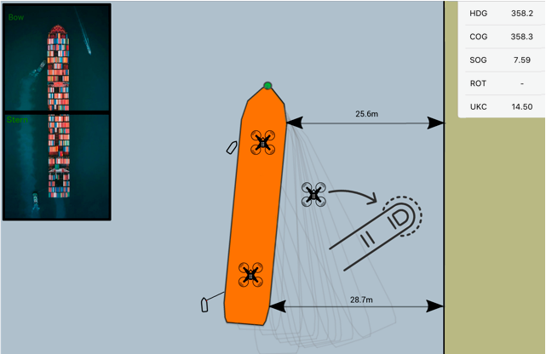
How far have we come?
Visualization on the Portable Pilot Unit (PPU)

Slide 13
How far have we come?
Still testing – Issues like, perception, visibility, weather, language skills, batteries etc.
Will it work?
Legislation?
Will the ships use the product?
If it works in port, it will also be at path to shore based pilotage for sea pilotage
Increased safety for marine pilots
Increased pilotage availability for more ships due to lower cost
More reliant and efficient operation

Slide 14
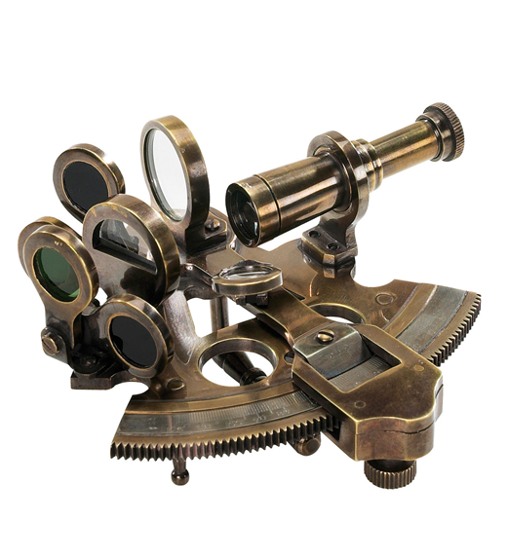
The future was here
Thank you ☺

