Slide 1

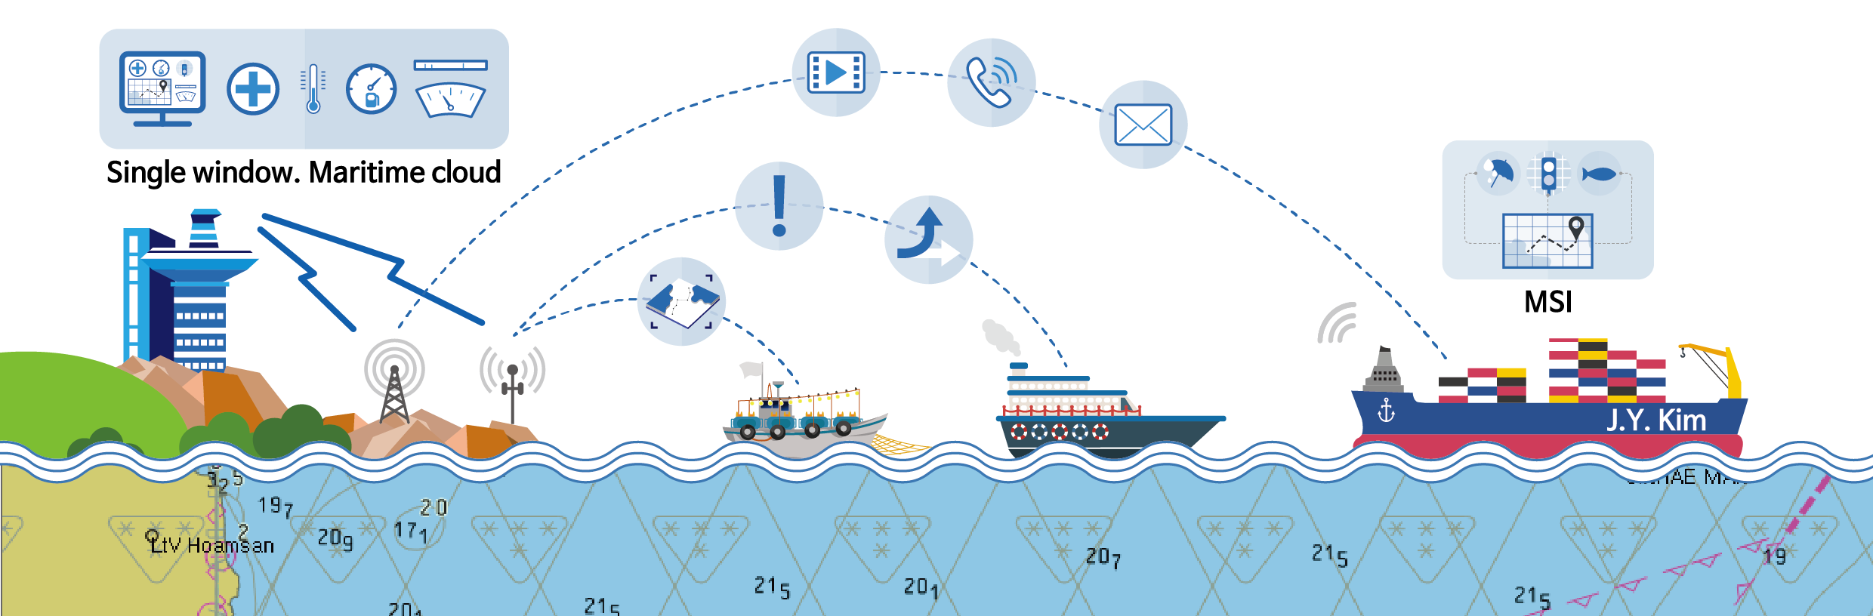
Case Study :
Korea SMART Shipping & Maritime Logistics
including SMART Port, e-Navigation and MASS
Discussion 1. What to be required to prepare ?
Discussion 2. What to be required to be done by Authorities ?
Head of e-Navigation Development Task Force
Director Sun-bae, Hong

Slide 2
Ⅰ
SMART
Shipping & Maritime Logistics
Ⅱ
Challenges
Ⅲ
Conclusion

Slide 3
Ⅰ
SMART Shipping
& Maritime Logistics
Background
Vision and Strategy

Slide 4
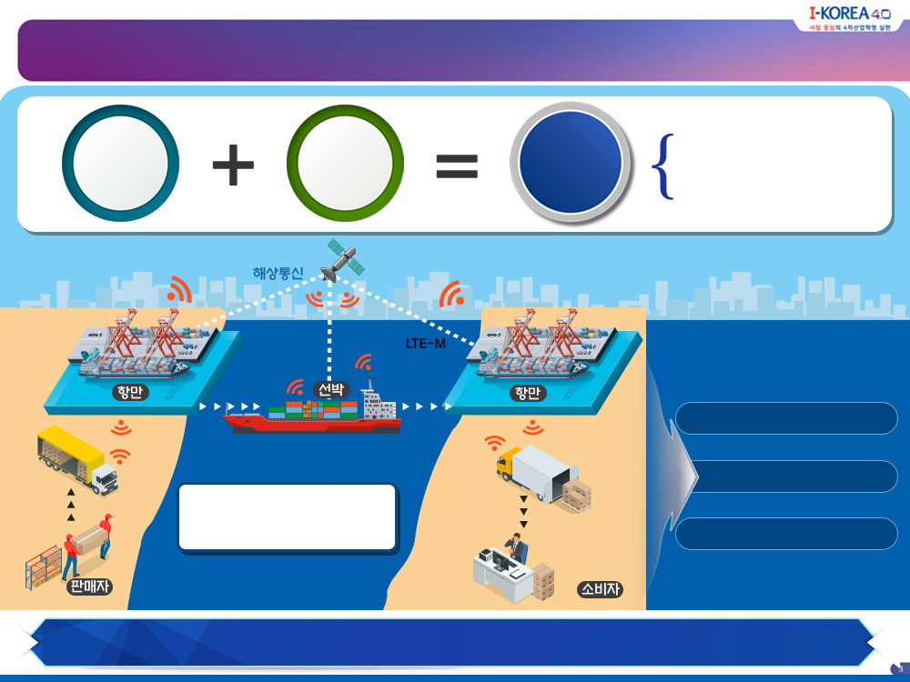

Background : Global Trend, Digitalization in Maritime
SMART
Maritime
Logistics
Digitalized, advanced facility
(port, vessel)
Maritime
Logistics
ICT
Technology
Connect with Logistic data information
Maritime
Communication Network
Port
Vessel
Port
Efficiency · Safety
Cost
Integrated operation and
Data information Sharing
Competitiveness
Seller
Customer
e-Navigation, STM, EfficienSEA, PCO, PortCDM, MASS
4

Slide 5
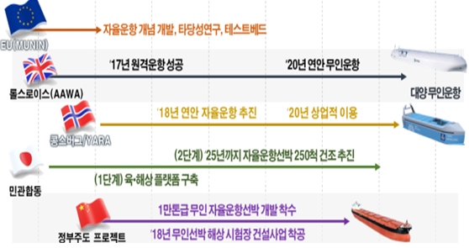
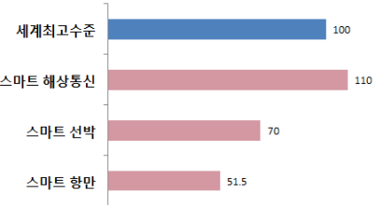
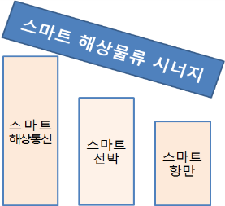
Background: Comparison btw Global and Korea
Developed Concept of Autonomous Navigation, Feasibility study, Testbed
Global
MASS
Compe-tition
2017: Succeed Remote navigation
2020: Coastal Unmanned navigation
Rolls-Royce(AAWA)
Unmanned navigation in Ocean
2018: Coastal Autonomous navigation
2020: Commercialization
Kongsberg/YARA
2nd Phase: 250 MASS in 2025
Gov.& Industry
1st Phase: Coastal/Maritime Platform
Start to develop 10K tonnage Unmanned MASS
Government lead Project
2018: Build Unmanned Vessel Test field
Republic of
Korea
Global Level
SMART Maritime
Communication Network
SMART Maritime Logistics Synergy
SMART Maritime Commu-nication Network
SMART Vessel
SMART Vessel
SMART Port
SMART Port

Slide 6
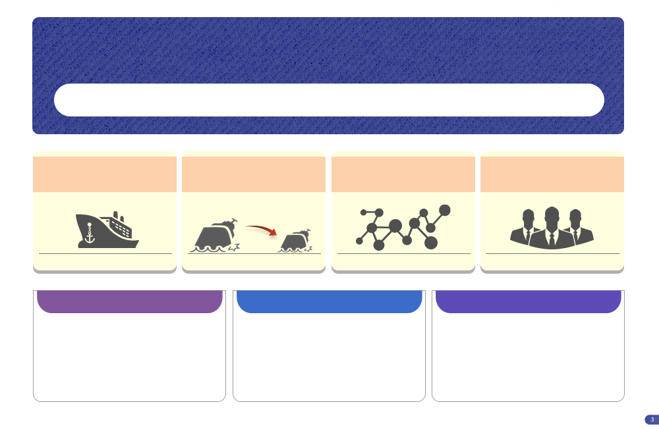


Vision : Globally Harmonized SMART Maritime Logistics
SMART Maritime Logistics 2030
Establishing Infrastructure 2025: Technology R&D• Complete Test &Validation
Reducing Loading/Unloading time
Zeroing Major Accident,
Reducing Accident over 50%
Implementing Data information ecosystem
Promoting 300 Start-Up
40 hrs
Within 24hrs
2,582
1,153
2025
2017
2025
2025
2025
Infrastructure
Job Creation
On-site realization by Pilot Project
Accelerating SMART vessel & Port
Set up the Data information ecosystem
R&D for New Technology
Support industry
Comprehensive Program for Start-up
Cultivating Experts
Public · Private Consultative Body
On-site realization automated facility
Commercialization
Incubating Start-up and establishing Data information ecosystem
6

Slide 7
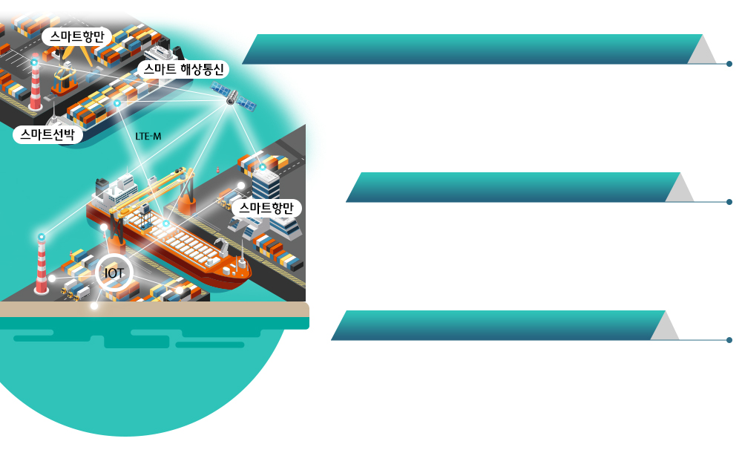
Strategy 1. Infrastructure
SMART Port
Advanced, Automated Port/ R&D of Autonomous Vessel technology
SMART Maritime Communication Network
Develop and validate Automated loading/Unloading
facility & advanced port operation system
Develop and Validate Autonomous Vessel Technology
SMART Vessel
Data map+ Data information
SMART Port
Make Diagram of Current Data information status &Demand condition
Analyzing information providing condition, Establishing Data information ecosystem
Establishing
Infrastructure
R&D for New Technology
Develop SMART Container
Develop Automated loading/unloading system of Autonomous vehicle

Slide 8

Strategy 2. Support Industry and Job creation
Support related Maritime Industry
Invest to R&D , Support Industry enter the global market
Support Start-Up from A to Z
Establishing Dedicated Center/ Cultivating Experts, Service development~ Support investment
Cultivating Experts and Job Creation
“Logistic + ICT”, “Seamanship + ICT” Cultivating Experts
Make Policy for Job creation
Support Industry & Job Creation
Public-Private consultative body
Private Consultative Body + Experts + Government
Continuous Communication· Develop policy
Notes:
ㅇ 해상물류의 스마트화와 연관업계를 지원하고 일자리를 창출하겠습니다.
ㅇ 관련 설비를 제작하고 시스템을 개발하는 연관 업계에 대하여
기업이 필요로 하는 R&D 및 해외시장 진출 지원을 추진하겠습니다.
ㅇ 해기분야, 컨테이너물류 분야 등
분야별 스타트업 육성을 전담하는 센터를 설립하고
인재양성에서부터 서비스개발, 투자유치까지
종합적으로 지원하는 프로그램을 만들 계획입니다.
ㅇ 지능화 등으로 인해 새롭게 만들어지는 일자리에 대한
전문인력 양성을 준비하는 한편,
자동화로 인해 전환되는 일자리에 대해
노사정 모두가 공감하는 일자리 대책을 마련토록 하겠습니다.
ㅇ 이러한 연관업계 지원에 대한 지속적인 협의를 위해
기존의 민간 협의체를 포함하고, 전문가, 정부실무자까지 포괄하는
민관 협의체를 만들어
지속적인 민간 간 협력 및 정부 정책 발굴 체계를 구축하겠습니다.

Slide 9
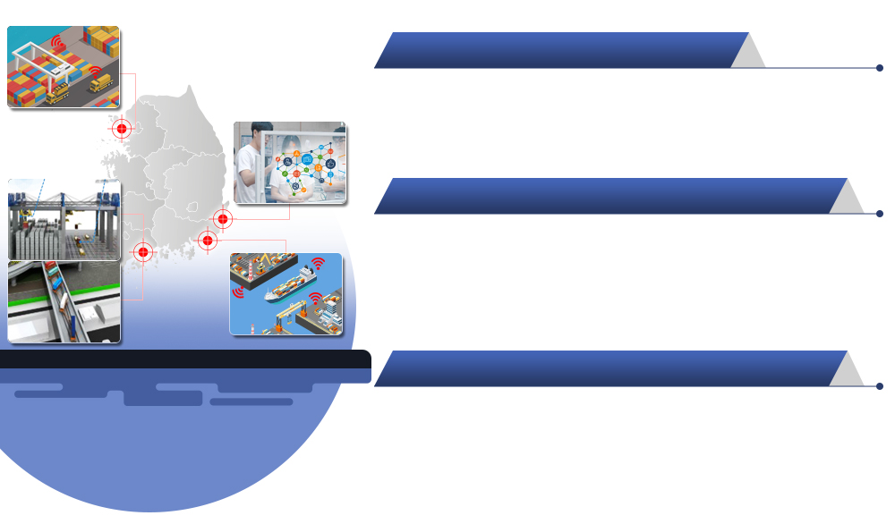
Strategy 3. Pilot project and On-site realization
Automated Port facility
Automated container loading/unloading+ Automated container Moving
인천항
Incheon
울산항
Advanced Port & On-Site realization
Ulsan
Application of IoT Technology in the Terminal , Efficient transition
Efficient connectivity between Port-Vessel, Port-Shore center
부산항
광양항
Busan
Gwangyang
Start-Up and Data information ecosystem
Pilot Project & On-site Realization
Dedicated Center for Start-up
Create and Utilize of Data information ecosystem
Notes:
ㅇ 마지막으로 앞서 말씀드린 사업을
신속한 현장실증을 통해 보완하여 상용화를 준비할 계획입니다.
ㅇ 컨테이너 하역 자동화 설비와 컨테이너 이송 자동화 설비를
광양항에서 연계 실증하여 종합적인 자동화 항만의 모델을 도출하고
ㅇ항만의 지능화와 주체간 연계 사업은
부산항과 인천항에서 추진할 예정입니다.
이를 통해 항만 내, 항만과 선박, 항만과 항만간의
효율적인 연계를 검증할 계획입니다.
ㅇ오일물류의 중심항인 울산항에서는
오일물류정보 생태계 구축과 스타트업 육성 사업을 추진할 계획입니다.

Slide 10

Expected Effects
Joining & Harmonizing Global Trend
Cost Down,
Safety/Efficiency Up
New Service & Job Creation
Establishing SMART Shipping &Maritime Logistics system
Domestic law, Government Subsidies, R&D, Forum

Slide 11
II
Challenges

Slide 12
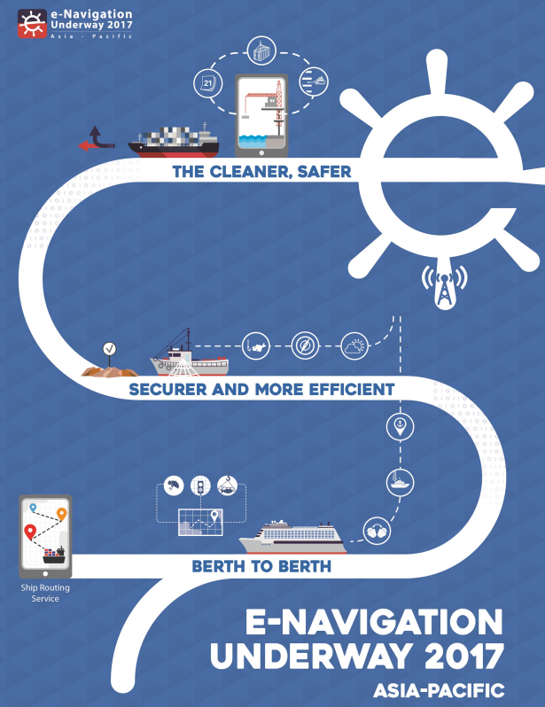
z
Conflict of Interests !
: Legal/Organizational systems
Standardization & Harmonization !
: Data-Sharing
Polarization & Mass Unemployment !
: Creating new jobs
Small/Petty industries !
: Non-SOLAS ships, Fisheries
No leading body, but Administration !
Let’s get our solution from the Digitalization !

Slide 13
III
Conclusion

Slide 14
z
Digitalization enabling innovation
across different sectors
Unavoidable Trend
New Paradigm for both Safety &
Efficiency. THIS time is Different !
In a beneficial way and goal based
approach to all stakeholders !
Administration should be a leading body !
Let’s get our solution from the Digitalization !

Slide 15
z
Digitalization, 4th Industrial Revolution in maritime sectors
might be divided in two era !
Pre - ( ) era
Standards, different from each others ? compatible/interoperable
Post- ( ) era
Let’s get our solution from the Digitalization !

Slide 16

z
Pre - ( Maritime )
Connectivity era
Post- ( Platform )
Let’s get our solution from the Digitalization !

Slide 17


I believe…...
We can do !
One step by 10 people
better than 10 steps by One !
Q. Who should be 10 People ?
Different stakeholders !
different Domain bodies
different Nations & Regions
different Industries & People

Slide 18
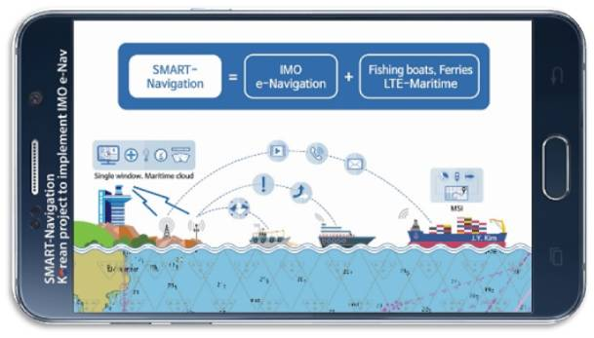
Thank you !
More people get their solutions from the
SMART- Shipping & Maritime Logistics

