Slide 1
Cyber Security
- tackling the risks involved
Ashok Srinivasan
Manager, Maritime Technology and Regulation
Email: asr@bimco.org
E-Nav underway 2019

Slide 2
Who we are and what we do..
BIMCO is the world’s largest international shipping association, with around 2,000 members in more than 120 countries. Our global membership includes shipowners, operators, managers, brokers and agents.
  Contracts and Clauses (from shipbuilding to recycling)
  Information on website ( Cargo databases, KPI system, Regulatory and technical content)
  Training – In-depth and high level training on commercial matters
  Support and advice
  Martech – Technical and regulatory affairs
Notes:
Talk more about the tech department

Slide 4
Cyber Security
  Cyber incident types , real life cases
  IMO work and the regulatory enviroment
  Industry Cyber security guidelines (3rd version)
  What is new in this version
  Steps that should be taken to make Cyber resilient ships

Slide 5
Cyber Survey by BIMCO and IHS Markit
Source: IHS Markit
Notes:
2019 survey is under preparation – more detail into education and training –
Type of attack and how they handled it inside the company
Result will be out during NOR shipping – released in a month’s time
Striking – spending less than 10K
Under reporting – because it can cause a damage to the company reputation
The law GDPR – you only have to let the individual when there is a significant risk.

Slide 6
Budget Allocation on Cyber Security
Source: IHS Markit
Notes:
2018 survey
2019 survey is under preparation – more detail into education and training –
Type of attack and how they handled it inside the company
Result will be out during NOR shipping – released in a month’s time
Striking – spending less than 10K
Under reporting – because it can cause a damage to the company reputation
The law GDPR – you only have to let the individual when there is a significant risk.

Slide 7
Cyber incidents have been happening
  Ship agent and shipowner ransomware incident
  Main application server infected by ransomware
  Worm attack on maritime IT and OT
  Crash of integrated navigation bridge at sea
  Navigation computer crash during pilotage
  Bunker surveyor’s access to a ship’s administrative network
  Unrecognised virus in an ECDIS delays sailings
Notes:
Increase line spacing

Slide 8
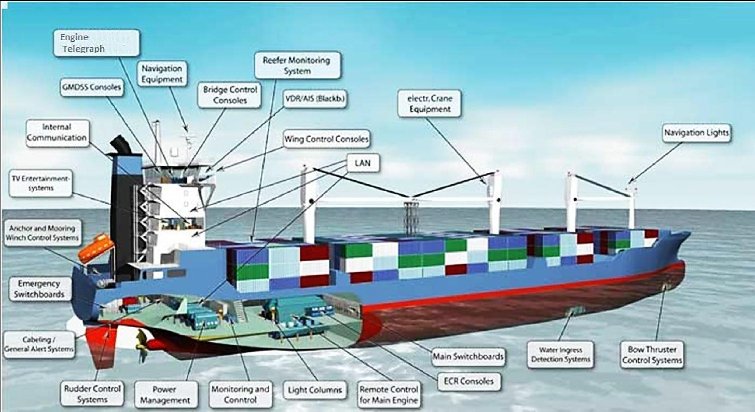

A complex network
A single protection layer might not be enough. Systems should be designed keeping security in mind and more layers of security is essential.
Picture source: Inmarsat

Slide 9

Cyber Security at IMO
  Regulation :
  MSC, at its 98th session in June 2017, adopted Resolution MSC.428(98) - Maritime Cyber Risk Management in Safety Management Systems.
  Encourages administrations/companies to include Cyber risk management in their SMS no later than first annual verification of DOC after 1 January 2021
Notes:
The resolution encourages administrations to ensure that cyber risks are appropriately addressed in existing safety management systems (as defined in the ISM Code) no later than the first annual verification of the company's Document of Compliance after 1 January 2021 (audit and PSC from 2022).
2016- 1st version -BIMCO and the Industry have been very active and gave tech advice

Slide 10
Regulatory space
  Regulation :
  IMO has issued MSC-FAL.1/Circ.3 Guidelines on maritime cyber risk management
  The important links in an effective cybersecurity management
Should start at senior management level
Effective cyber risk management
Culture of risk awareness at all levels
Constant and effective feedback mechanisms
Notes:
Version 3 is aligned with these guidelines

Slide 11
Guidelines
Guidelines on Cyber Security on board Ships issued by BIMCO, CLIA, ICS, INTERCARGO, INTERMANAGER, INTERTANKO, IUMI, OCIMF and WSC.
IEC 27001 standard on Information technology – Security techniques – Information security management systems – Requirements. Published jointly by the International Organization for Standardization (ISO) and the International Electrotechnical Commission (IEC).
United States National Institute of Standards and Technology's Framework for Improving Critical Infrastructure Cybersecurity (the NIST Framework).
Notes:
All other guides on IT
IT – data
OT – real ships

Slide 12
Cyber Survey by BIMCO and IHS Markit
Source: IHS Markit
Notes:
2018 survey ??
2019 survey is under preparation – more detail into education and training –
Type of attack and how they handled it inside the company
Result will be out during NOR shipping – released in a month’s time
Striking – spending less than 10K
Under reporting – because it can cause a damage to the company reputation
The law GDPR – you only have to let the individual when there is a significant risk.

Slide 13
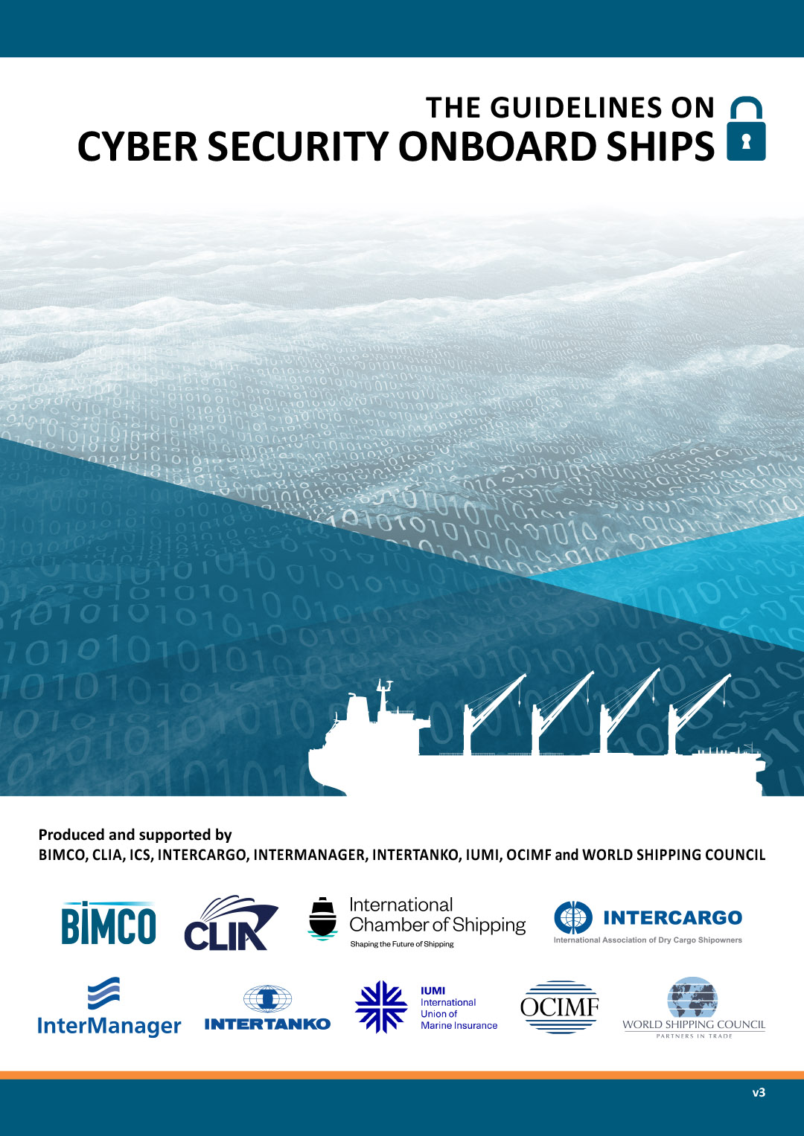
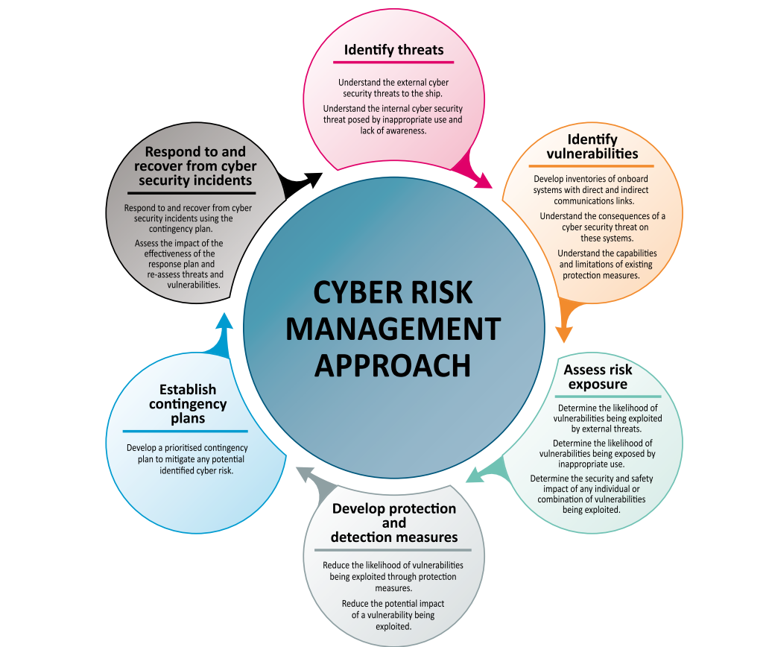
Accepted by shipowners, classification societies and the International Maritime Organisation

Slide 14
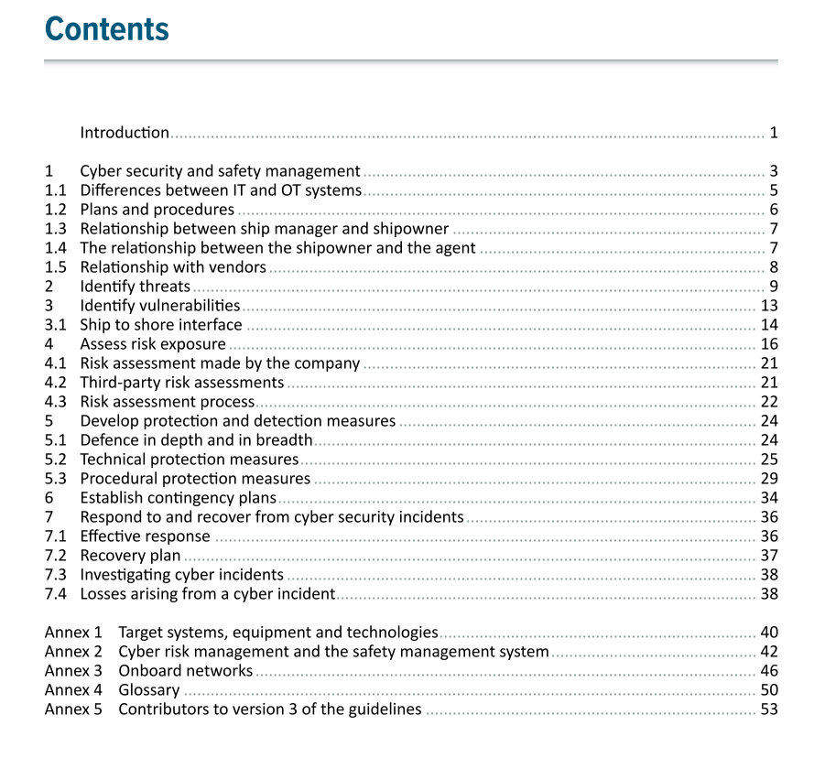
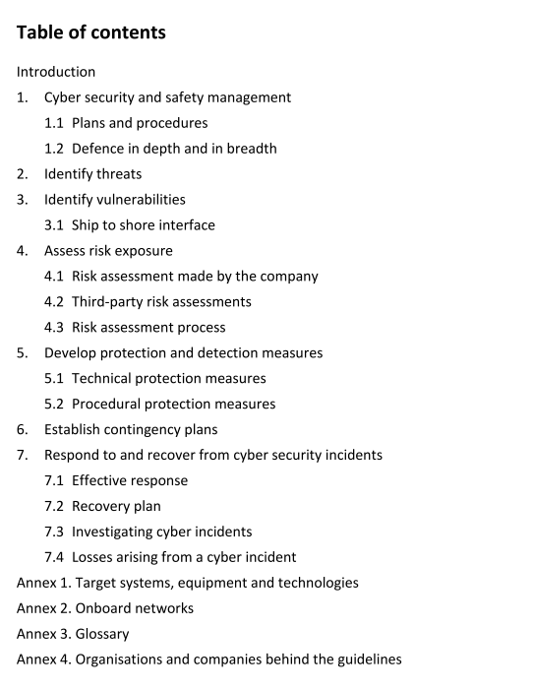
The differences
Version 3
Version 2
Notes:
Animate to bring the difference.

Slide 15
The differences between v2 and v3
1.1 Differences between IT and OT systems
1.3 Relationship between ship manager and shipowner
1.4 The relationship between the shipowner and the agent
1.5 Relationship with vendors
Annex 2 Cyber risk management and the safety management system
Notes:
Animate to bring the difference.

Slide 16
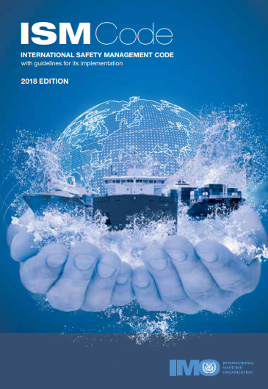
Annex 2: Cyber risk management and safety management system
  Links the Cyber risk mangement to the ISM code (step by step)

Slide 17
Annex 2: Cyber risk management and safety management system
  Example:
  Industry Guidelines: 1.1 connects with ISM Code: 3.2 Update the safety and environment protection policy to include reference to the risk posed by unmitigated cyber risks.
Notes:
OT – directly connects safety and environmental

Slide 18

Human factor in Cyber incident
  Cyber attack can spread very quickly between ships and offices
  Disconnection procedure should not be long
  Just have a simple network cable disconnection or a simple stop switch
Notes:
Seafarer- Accident – Complexity -

Slide 19

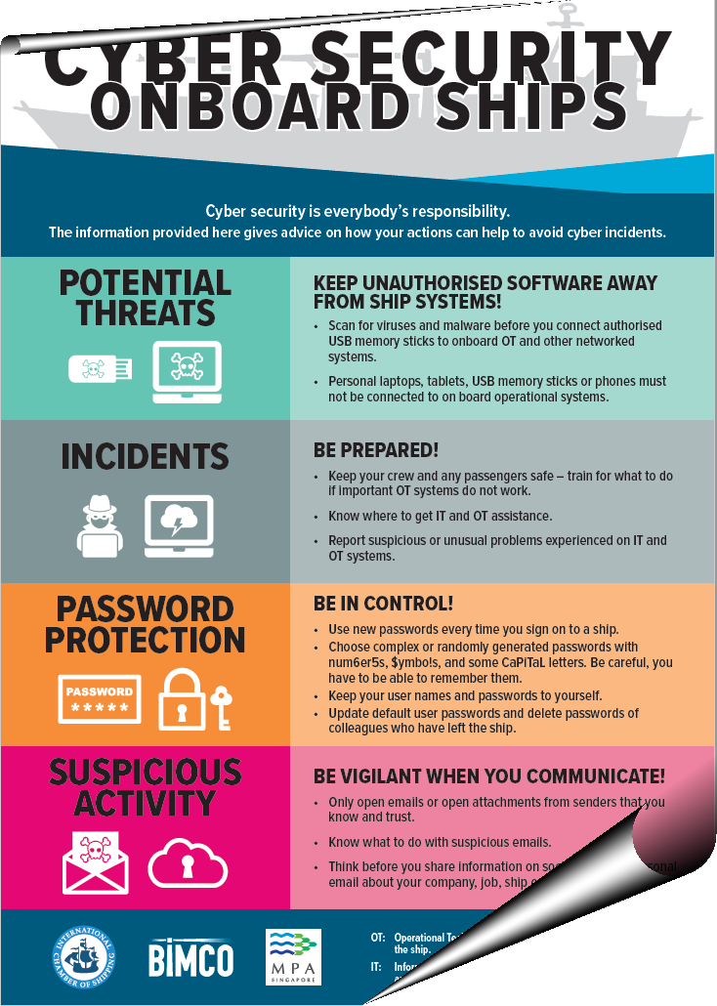
Annex 2 - Cyber risk management and safety management system
Cyber resilient ships
Equipment software should be designed with cyber risks in mind
Ships should be built in a cyber resilient way
The cyber risk must be managed by the shipowner

Slide 20
International Association of Classification Societies (IACS) recommendations on how to build new cyber resilient ships
Recommendation 1 'Software Maintenance'
Recommendation 2 ‘Manual Backup’
Recommendation 3 'Contingency Post Failure'
Recommendation 4 'Network Architecture'
Recommendation 5 'Data Assurance'
Recommendation 6 'Physical Security'
Recommendation 7 'Network Security'
Recommendation 8 'Vessel System Design '
Recommendation 9 'Programmable System Equipment Inventory'
Recommendation 10 'Integration'
Recommendation 11 'Remote Update / Access'
Recommendation 12 'Communication and Interfaces'
To become mandatory
Notes:
Industry recommends to bring this into 1 or 2

Slide 21

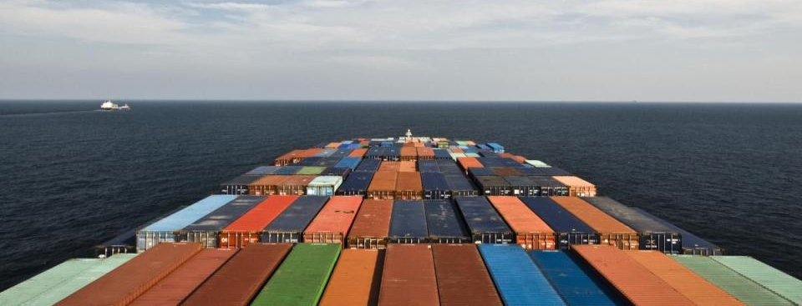
The way forward ?
In the era of digitalization, the approach to cyber security should be proactive and not reactive.
Build cyber resilient ships
Keep the software updated and do it the right way
Prepare SMS, Implement the cyber policies and procedures and make them a way of life. Just like personal safety!

Slide 22
For more information, please contact: martech@bimco.org / asr@bimco.org

