Slide 1
Danish Strategy and Initiatives on Maritime Cyber Security
February 8th 2019
Bjørn Borbye Pedersen

Slide 2
IS Cyber security a top-three safety concern?

Slide 3
Do you have the right measures to mitigate the risks?

Slide 4


Slide 5
Could this happen with a vessel?

Slide 6
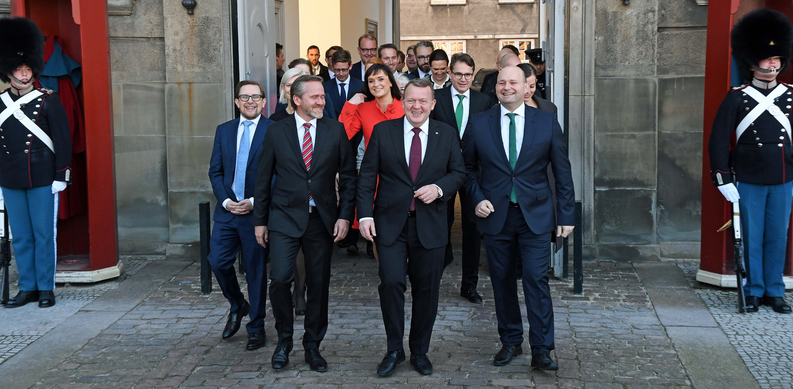
Governments strategy on cyber security
Source: flickr.com/venstredk

Slide 7

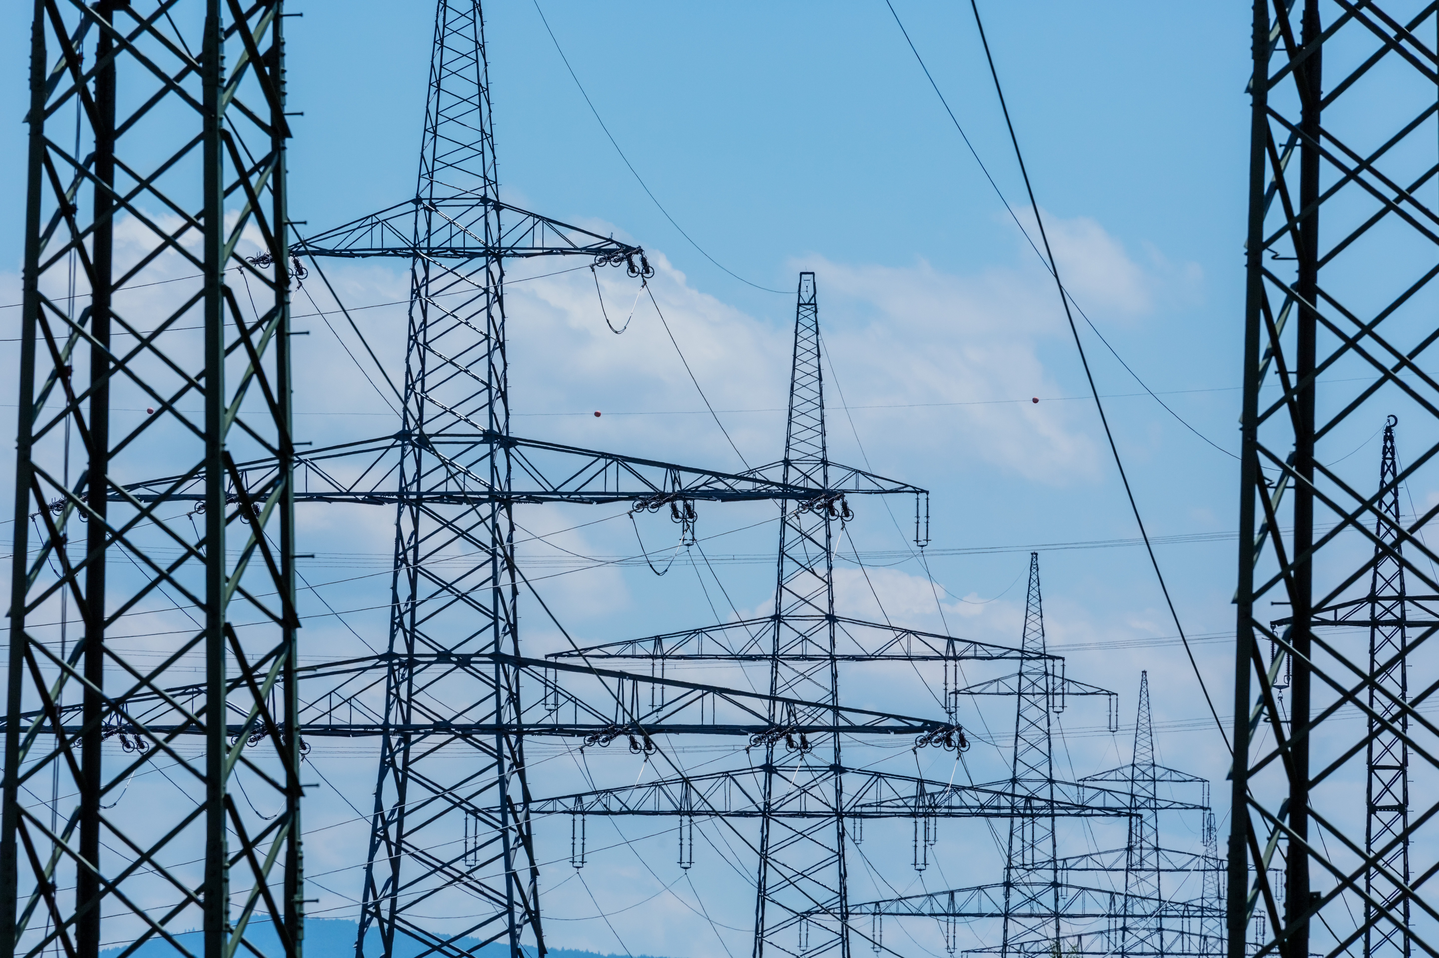
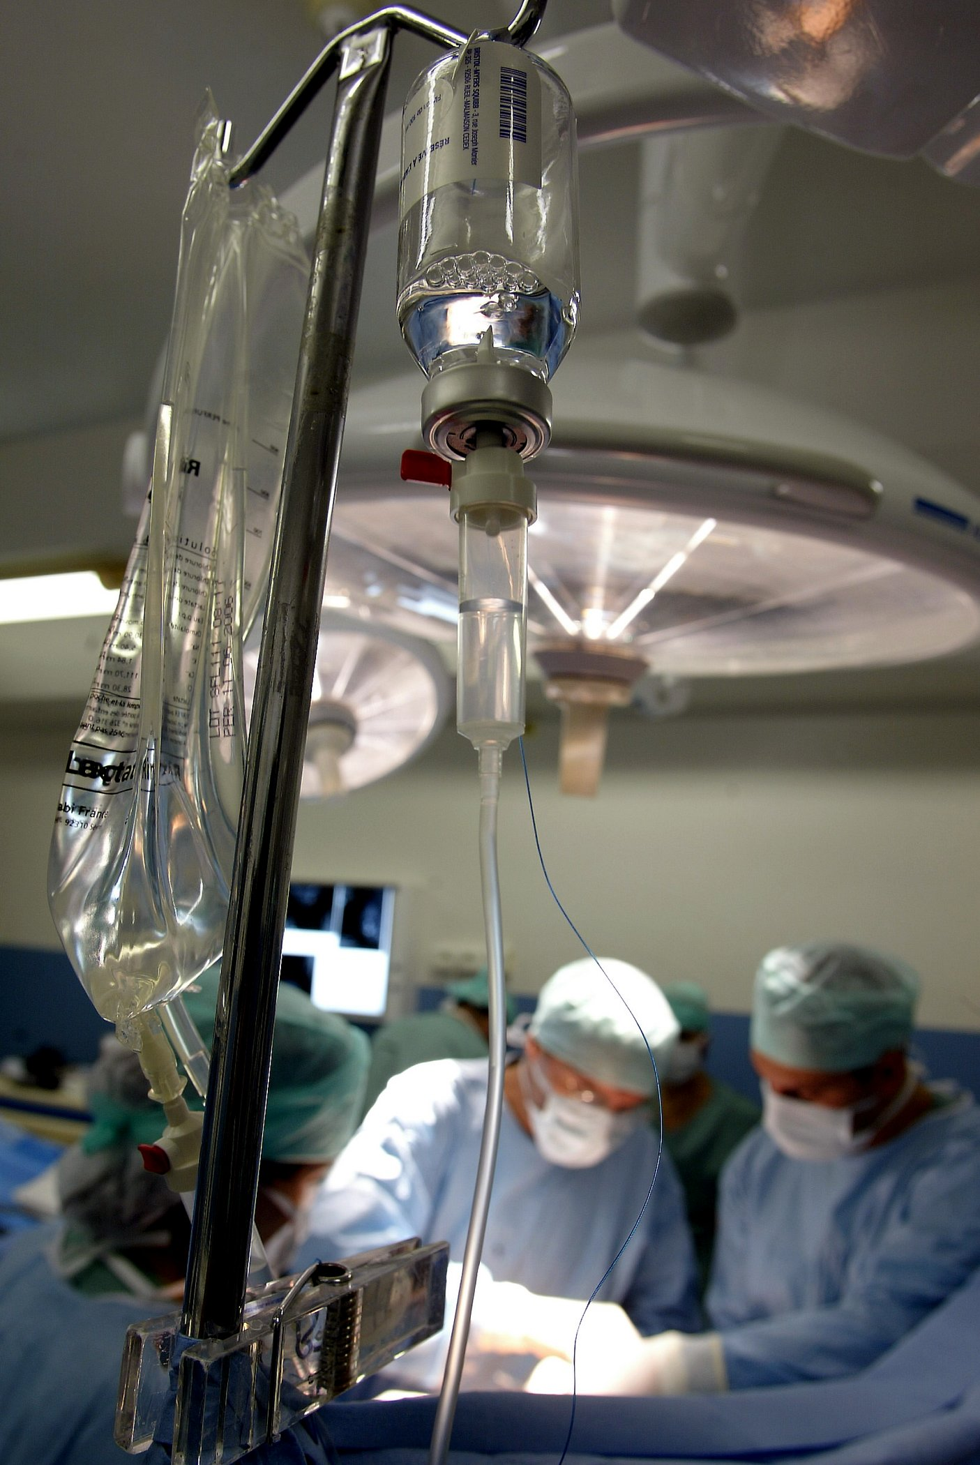
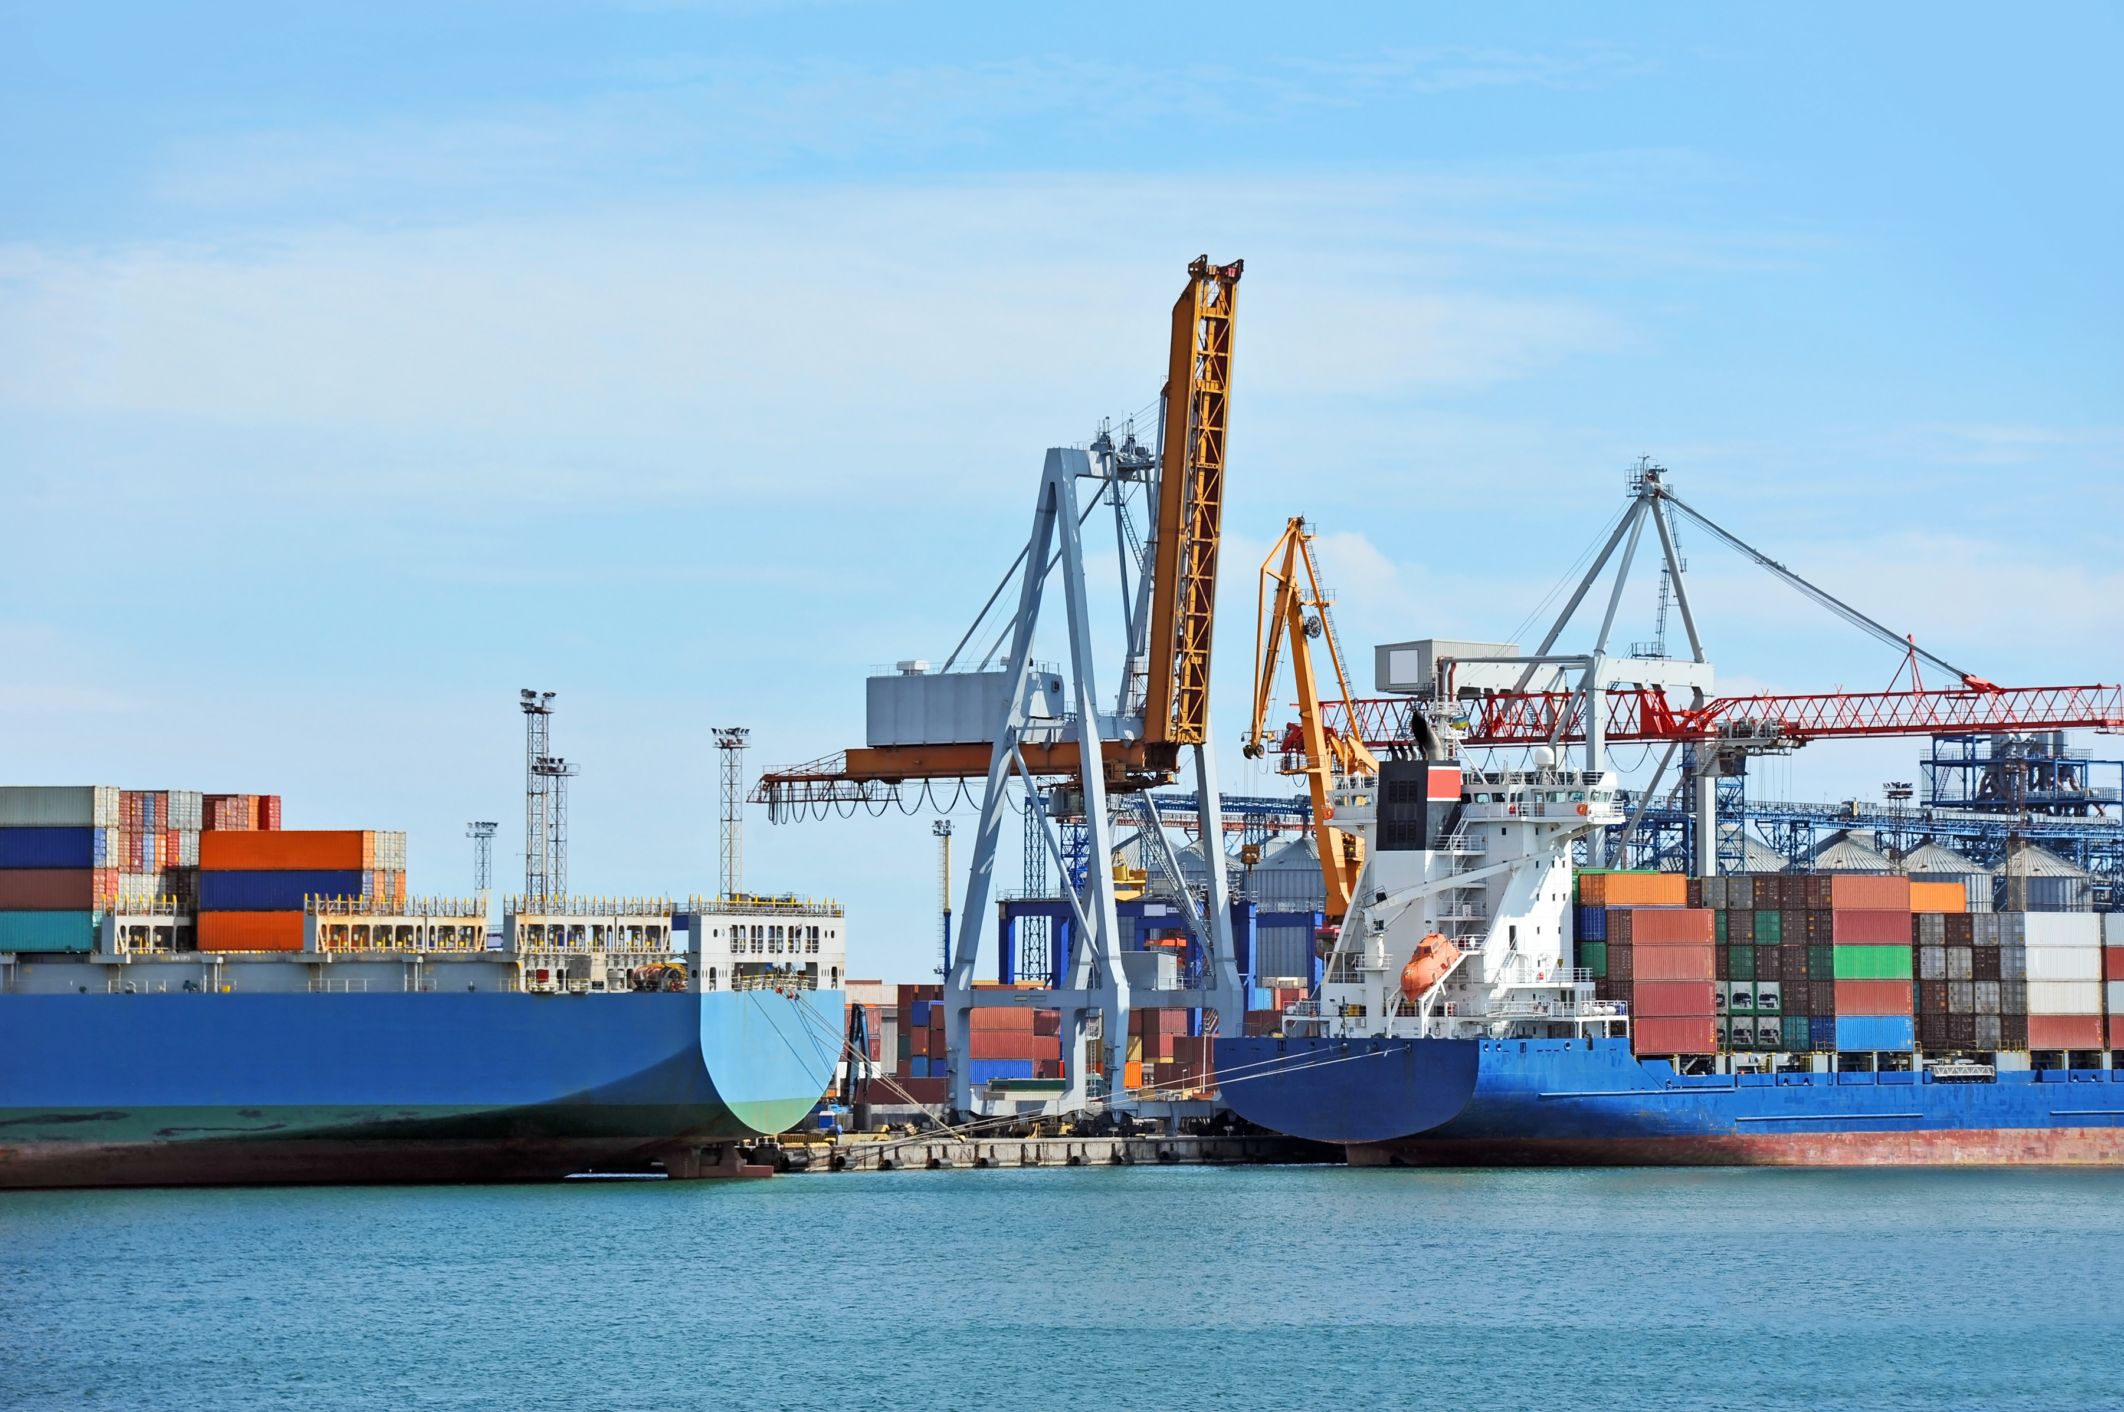
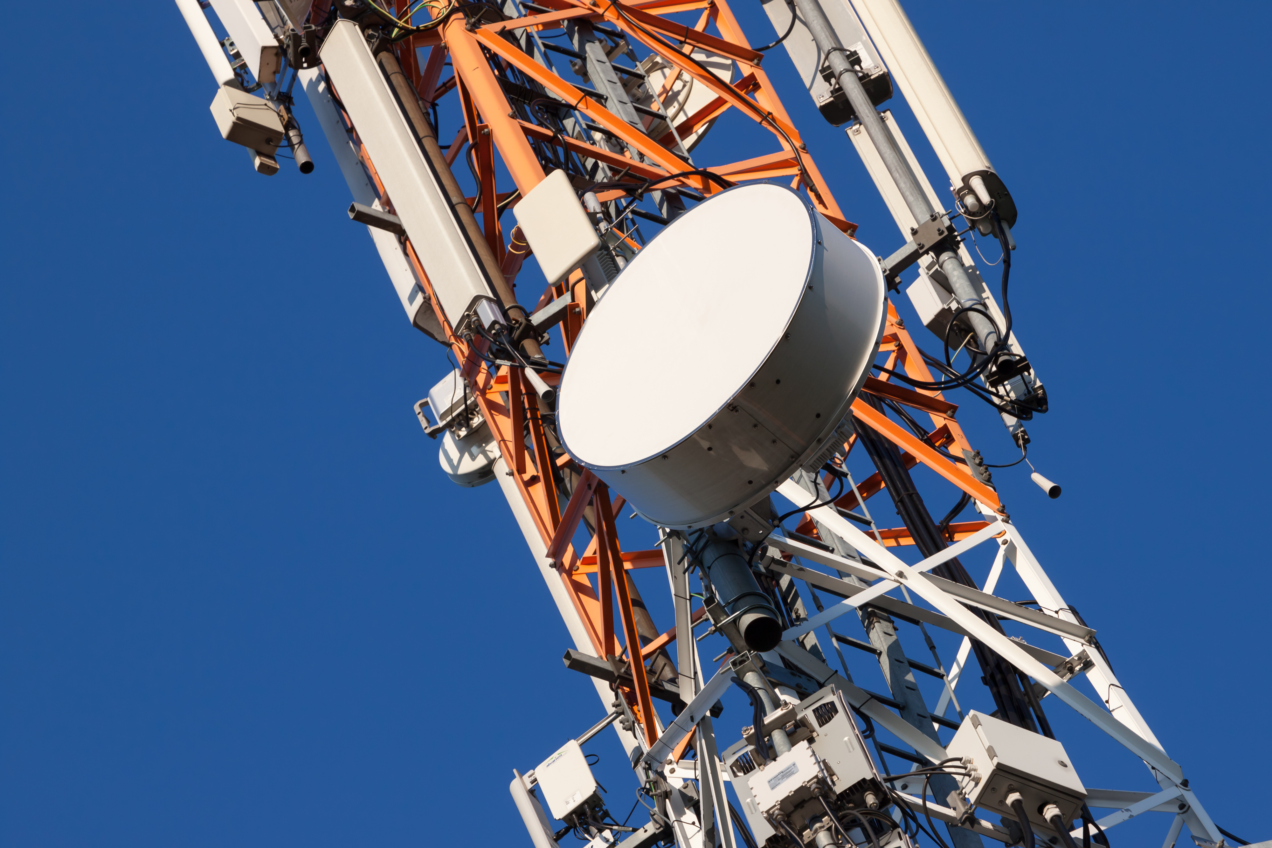

Critical sectors

Slide 8
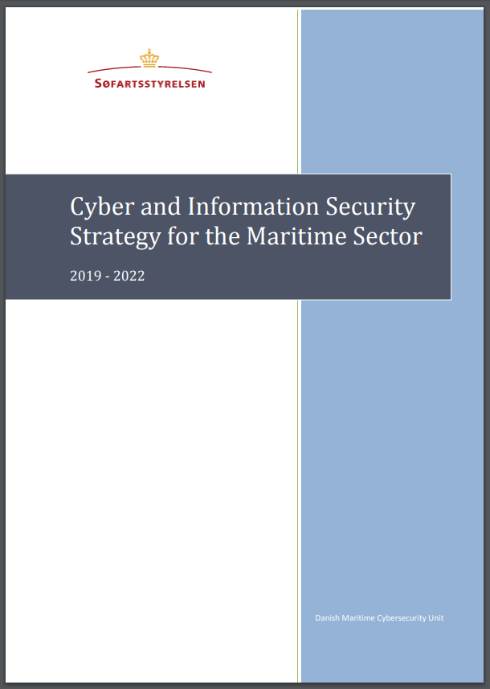
The objective is to ensure that safety in Danish waters and on board Danish ships is not compromised by cyber attacks.

Slide 9
Initiatives
The Danish Maritime Cyber Security Unit
Gateway to Centre for Cyber Security CFCS
Secondment of DMA employee at the CFCS
Implementation of EU and International law
Recommendations
Awareness campaigns
Standards for Cyber Security Management
Emergency response
Maritime Cyber and Information Security Forum

Slide 10
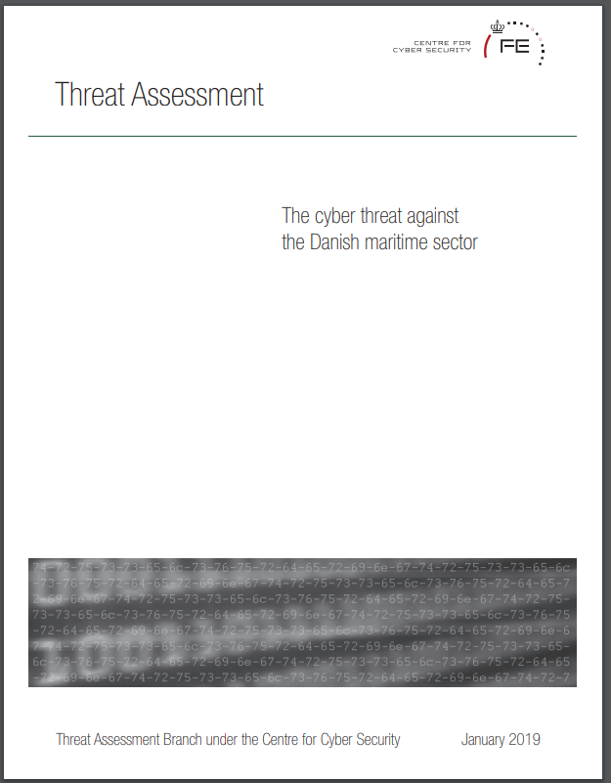



Slide 11



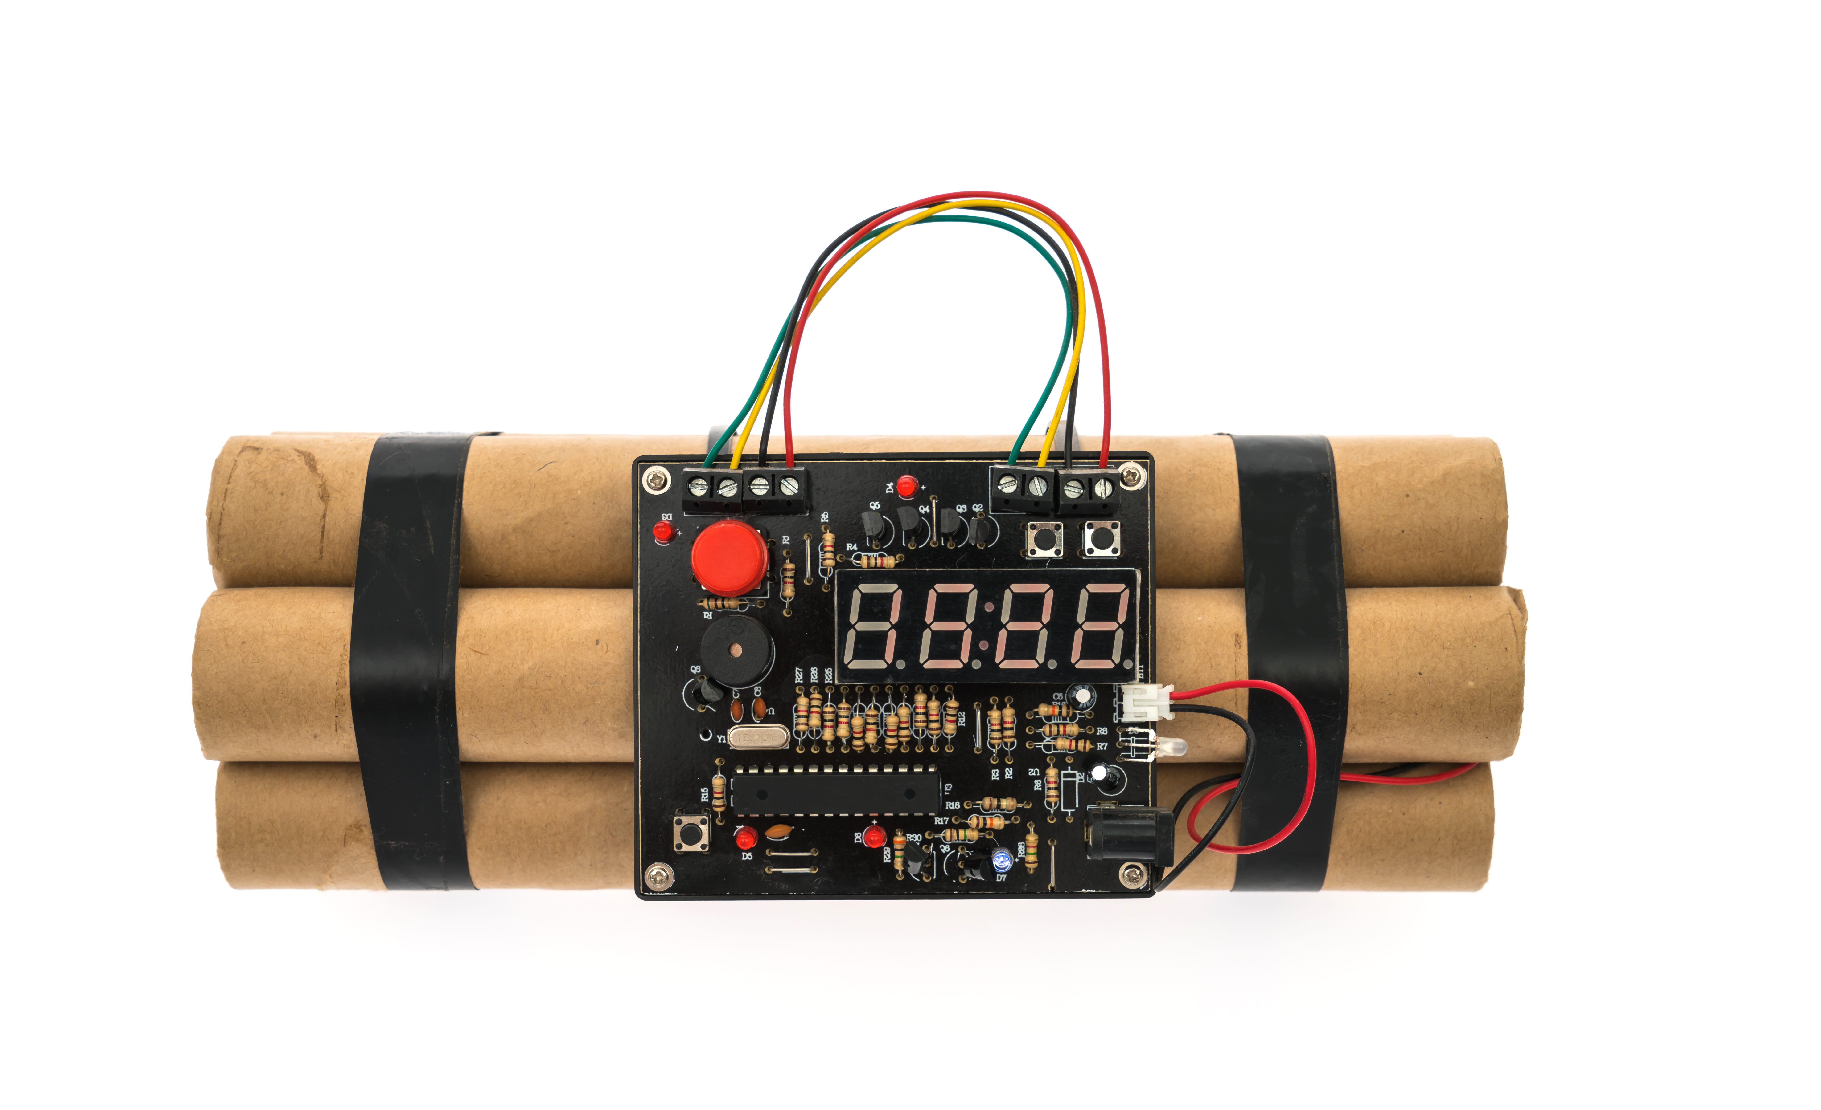
Four actor groups
VERYHIGH !
LOW!
VERYHIGH !
LOW!

Slide 12
DANISH MARITIME AUTHORITY
@DMA_SFS
WWW.DMA.DK

Slide 13


Logos PNG
For Copy/Paste

